Slide 1
Blood Clot and Pulmonary Embolism Policy (BCPEP)
November 21, 2024
This meeting is being recorded

Slide 2
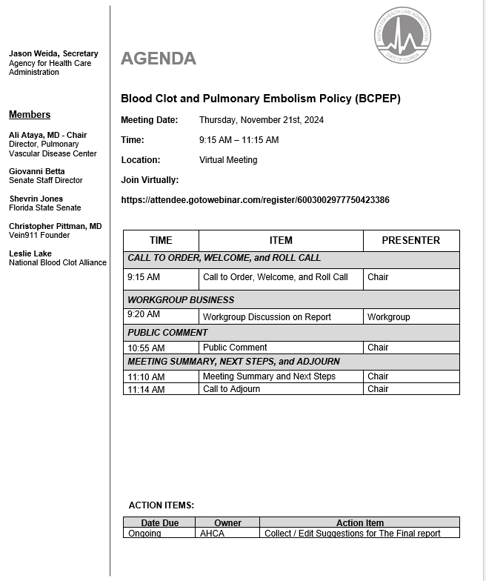

Slide 3
Call to Order, Welcome, and Roll Call

Slide 4
BCPEP Report
Workgroup Discussion

Slide 5
Public Comments

Slide 6
Meeting Summary

Slide 7
Next Steps

Slide 8
Adjournment

Slide 9
THANK YOU

