Slide 1
Blood Clot and Pulmonary Embolism Policy (BCPEP)
October 31, 2024
This meeting is being recorded

Slide 2
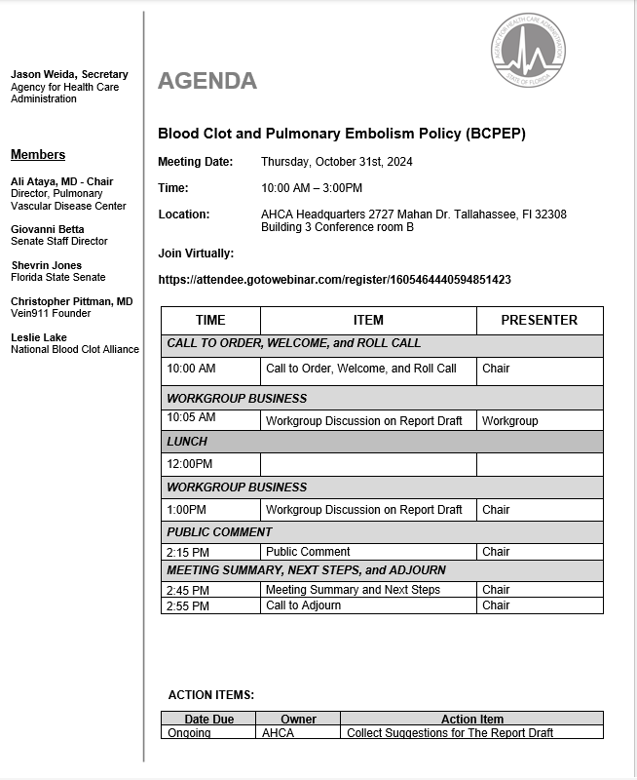

Slide 3
Call to Order, Welcome, and Roll Call

Slide 4
BCPEP Policy Report Review

Slide 5
Report Draft Workgroup Discussion

Slide 6
Lunch

Slide 7
Report Draft Workgroup Discussion

Slide 8
Public Comments

Slide 9
Meeting Summary

Slide 10
Next Steps

Slide 11
Adjournment

Slide 12
THANK YOU

