Slide 1
Blood Clot and Pulmonary Embolism Policy (BCPEP)
August 21, 2024
This meeting is being recorded

Slide 2
Agenda

Slide 3
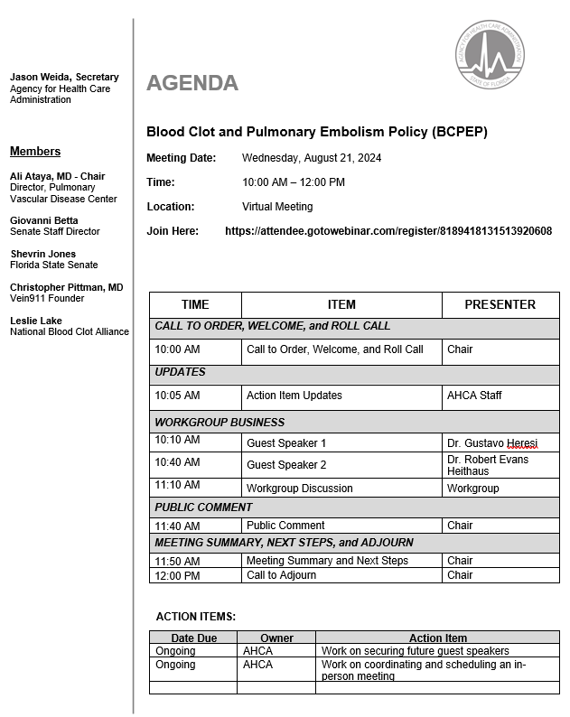

Slide 4
Call to Order, Welcome, and Roll Call

Slide 5
Previous Action Items and Status Updates

Slide 6
Guest Speaker: Dr. Gustavo Heresi

Slide 7
Chronic Complications of Pulmonary Embolism
Gustavo A. Heresi, MD, MS
Section Head, Pulmonary Vascular Section
Division of Pulmonary Medicine
Cleveland Clinic, OH

Slide 8
Chronic Thromboembolic Pulmonary Hypertension (CTEPH)
Pulmonary hypertension (PH) arising from single or recurrent pulmonary emboli
Incomplete resolution of emboli obstructs or narrows major pulmonary arteries
Progressive microscopic vasculopathy develops over time

Slide 9
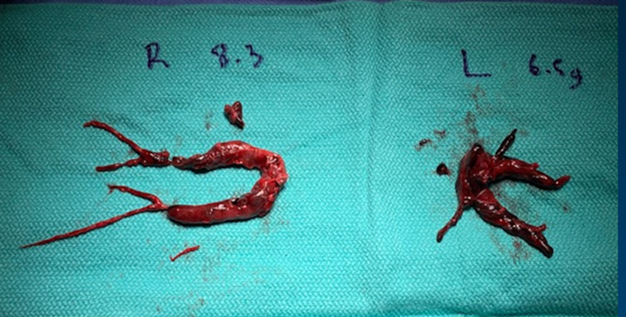
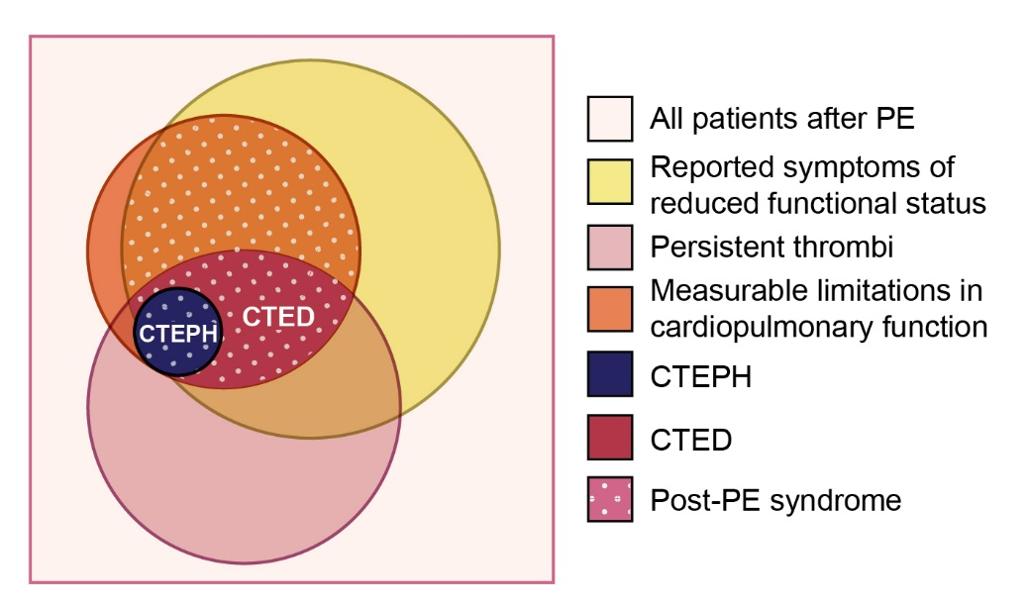
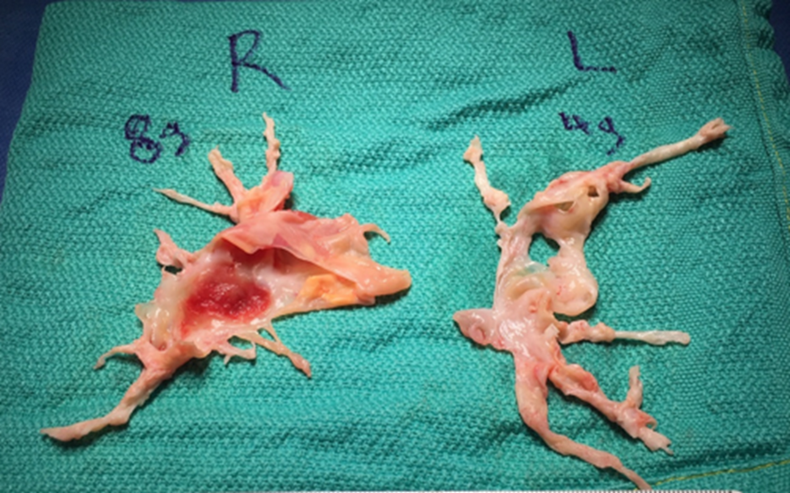
Spectrum of Post-PE Outcomes
Mahar J, Renapurkar R, Heresi GA. 2020. Pulmonary Embolism. Springer Nature Switzerland AG
Notes:
Overview of the different chronic consequences two years after PE: reported symptoms of reduced functional status or quality of life (~50% of patients), persistent thrombi (~25–33% of patients), persistent or worsening parameters of cardiac or pulmonary function (~10–30% of patients), and CTEPH (~0.5–4.0 of patients). The relative size and overlap of the circles are expected to change over time. We propose to consider the post-PE syndrome in the presence of measurable limitations of cardiopulmonary function after an index PE event, in combination with deterioration of the clinical symptoms, functional status or quality of life of the patient (stripe pattern).

Slide 10
Multicentre Prospective Cohort Study
Valerio L, et al. Eur Heart J 2022. doi:10.1093/eurheartj/ehac206

Slide 11
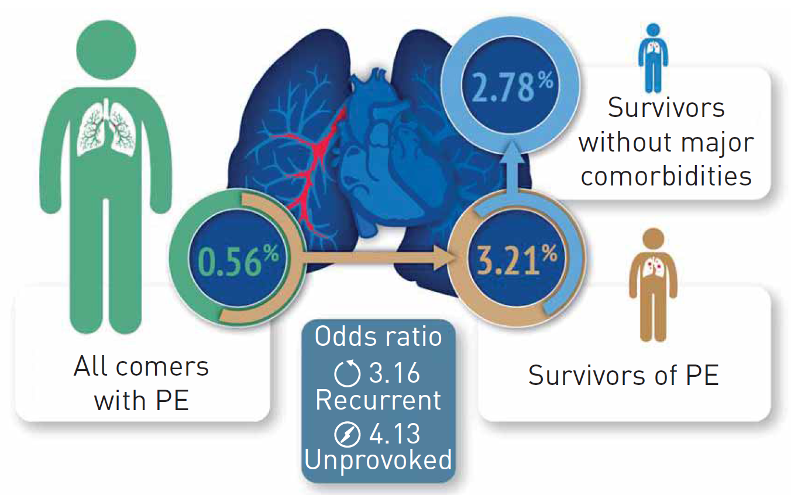
Meta-Analysis
16 studies, low bias, used RHC for CTEPH Dx
Ende-Verhaar YM, et al. Eur Respir J 2017
Notes:
16 studies, low bias, used RHC for CTEPH Dx

Slide 12
Diagnostic Process
1. Persistent symptoms after acute PE
2. PH
3. Unexplained dyspnea
Suspect
Echo for RV / PH
VQ for perfusion defects
Screen
Confirm
CTPA +/- DSA for extent and location
RHC for hemodynamics

Slide 13
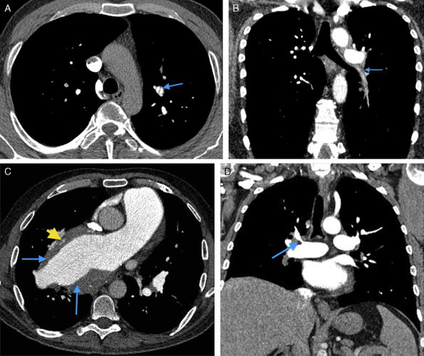
Renapurkar R, Shrikanthan S, Heresi G, Lau C, Gopalan D. J Thoracic Imaging. 2017;32:71-88
Notes:
CTA appearances of chronic thrombi in different patients with CTEPH: web (arrow in A), vessel atrophy with poor contrast opacification (arrow in B), eccentric thrombus (arrow) and calcified mural thickening (yellow arrowhead) (C), and stenosis with poststenotic dilation (arrow in D).

Slide 14
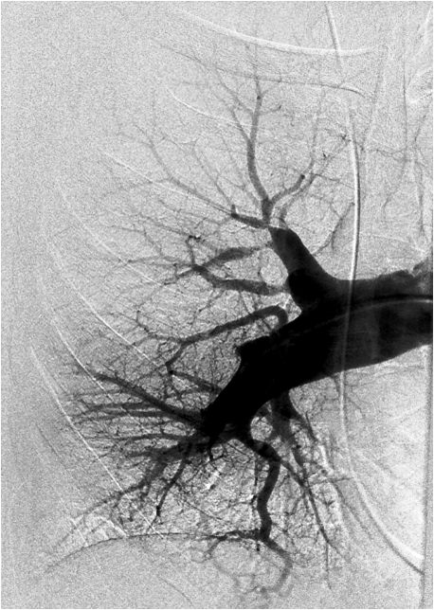
Narrowing, Stenosis, Cutoff
Notes:
Left panel – retraction and stenosis of LLL lobar artery
Right panel – stenosis and tapering of RUL artery; abrupt cutoff of RML artery

Slide 16
Management Strategy

Slide 17
CTEPH is a Surgical Disease

Slide 18
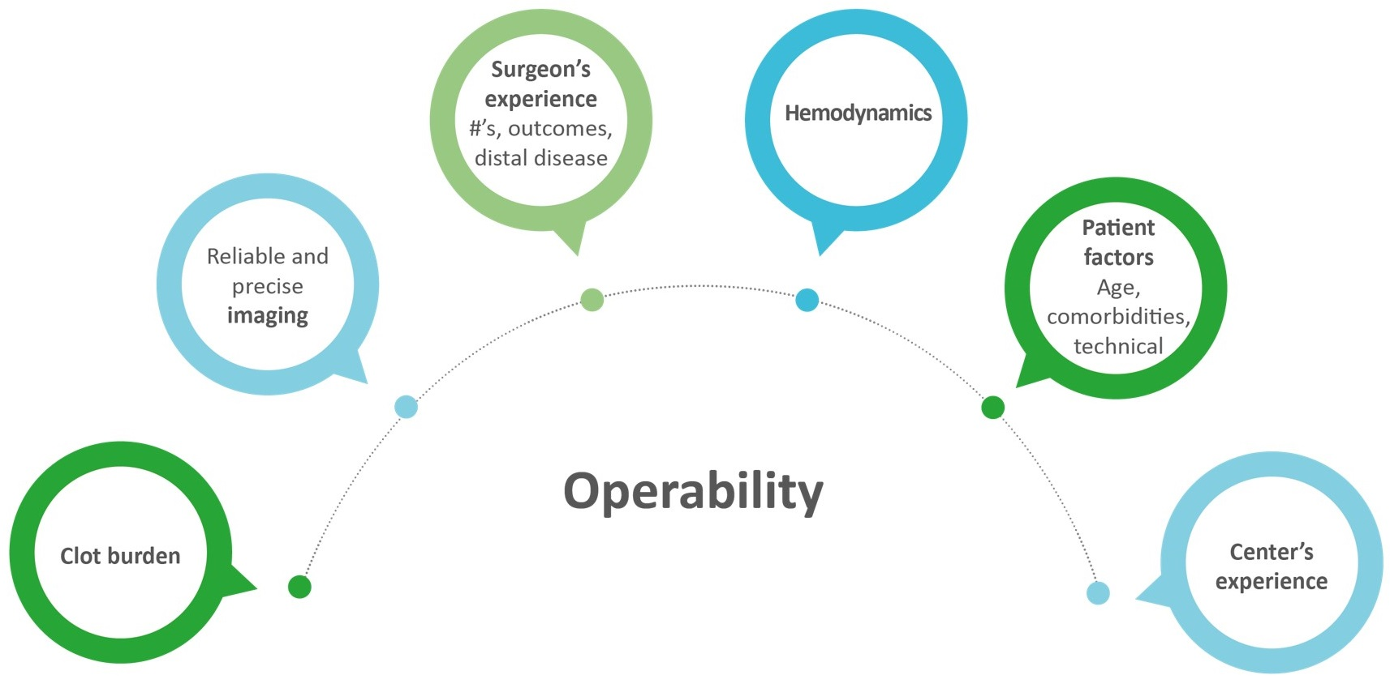
Operability Assessment
Kim NH et al. Eur Respir J. 2019; 53: 1801915

Slide 19
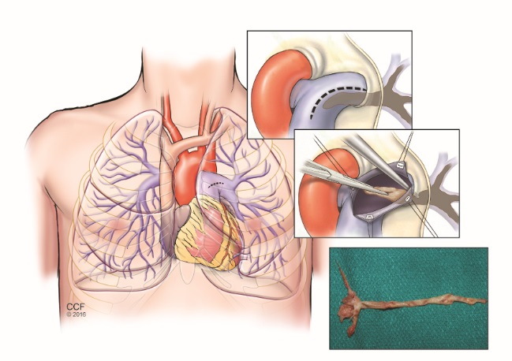
Surgical Considerations
Median sternotomy
Endarterectomy, NOT embolectomy
Cardiopulmonary bypass
LV venting
Circulatory arrest
Deep hypothermia 20°C
Barbiturate, phenytoin,
steroids
Collateral flow
Notes:
Heart fibrillates at around 24 degrees centigrade, then insert AV vent
Vent across MV it the LV

Slide 20
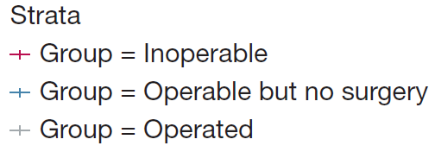
US CTEPH Registry Survival
Chin KM, et al. Chest Pulmonary 2024

Slide 21
International CTEPH Registry: Patient Disposition
Recruited
n = 679
60%
Operated
Non-operated
40%
n = 404
n = 275
38 refused
112 surgical inaccessible disease
24 imbalance PVR – accessible disease
4 PVR > 1500 dynes
5 age
32 comorbidities
42 other / 18 unknown
Delcroix M, et al. Circulation. 2016
Notes:
140/679 (21%) technically inoperable

Slide 22
Randomized Placebo-Controlled Clinical Trials for Treatment of CTEPH
Year | Drug | Study | Patient Population | (n) | Background Therapy? | Intervention | Primary Endpoint | Main Finding | Approval
2008 | Sildenafil[1] |  | Inoperable | 19 | No | Sildenafil (40mg TID) vs. placebo | 6WMD | Did not meet primary endpoint to significantly change 6WMD Increased WHO FC and cardiac index, reduced PVR and Nt-PRONP | No
2008 | Bosentan[2] | BENEFiT | Inoperable or Residual PH after PTE | 157 | No | Bosentan (62.5-125mg BID) vs. Placebo | 6WMD, Change in PVR | Met one primary end point-reduced PVR by 24% Did not significantly change in 6MWD | No
2013 | Riociguat[3] | CHEST-1 | Inoperable or Residual PH after PTE | 261 | No | Riociguat (0.5-2.5mg TID) vs. Placebo | 6WMD | Met primary endpoint-Increased 6WMD Increased WHO FC, reduced PVR and NT-proBNP | USA, Europe, Japan
2017 | Macitentan[4] | MERIT-1 | Inoperable | 80 | Yes | Macitentan (10mg daily) vs. Placebo | Change in PVR | Met primary endpoint- reduced PVR by 26% Increased 6WMD, reduced NT-proBNP | No
2018 | Treprostinil[5] | CTREPH | Inoperable or Residual PH after PTE | 105 | Yes | Treprostinil 30ng/kg/min vs. Treprostinil 3ng/kg/min | 6WMD | Met primary endpoint- increased 6WMD Increased WHO FC, reduced PVR and NT-proBNP | Europe
2022 | Selexipag [29] |  | Inoperable or Residual PH after PTE | 78 | Yes | Selexipag (200-1600mcg BID) vs. Placebo | Change in PVR | Met primary endpoint- decreased PVR Did not significantly improve 6WMD | Japan
Goyanes AM, Heresi GA. Advances in Pulmonary Hypertension 2022

Slide 25
Multimodal CTEPH Treatment
10-40 mm
2-10 mm
0.5 - 2 mm
< 0.5 mm
Eur Respir J 2022

Slide 26
Health Economic Impact of Earlier CTEPH Diagnosis
Incremental cost–utility ratio EUR 21900/QALY
Boon G, et al. ERJ Open Res 2021
Notes:
Our constructed model based on the Dutch healthcare setting demonstrates a substantial health
gain when CTEPH is diagnosed earlier. According to Dutch health economic standards, additional costs
remain below the deemed acceptable limit of EUR 50000/QALY for the particular disease burden. This
model can be used for evaluating cost-effectiveness of diagnostic strategies aimed at reducing the
diagnostic delay.

Slide 27
CTEPH Societal Costs
Kjellström B, et al. Pulm Circ 2023
Notes:
CTEPH was associated with large societal costs related to healthcare
consumption and productivity loss, both before and after diagnosis.
Swedish databases

Slide 28
Guest Speaker: Dr. Robert Evans Heithus

Slide 29
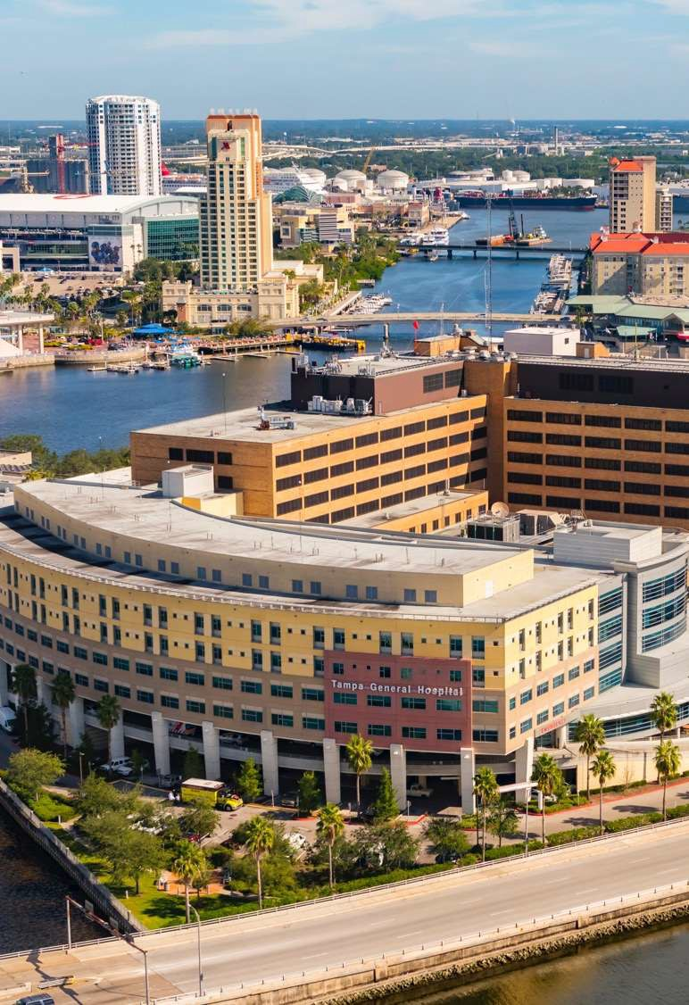
2024 update on PE interventional techniques for PE intervention
Robert Evans Heithaus, MD Vascular & Interventional Radiology

Slide 30
Epidemiology
CDC date showed as many as 900,000 patients have deep venous thrombosis (DVT) or pulmonary embolism (PE) in the US each year
Stated a different way that is 1-2 PE episodes per 100,000 people
Up to 10 PE episodes per 1000 people in the elderly population
100,000 deaths per year***
Mortality largely driven by severity of presentation
Low Risk
Intermediate Risk
High Risk

Slide 31
Pulmonary Embolism Classification
Low Risk | Submassive or Intermediate Risk | Massive or High Risk
No presentation of clinical or | RV strain without | Hypotension defined as: Systolic blood pressure <90 mmHg Drop of >40 mmHg for at least 15 minutes Need for vasopressor
hemodynamic signs | hypotension
Little to no right | RV/Left ventricular (LV) ratio
ventricular (RV) dysfunction | >0.9
 | Pressure overload detected
 | by an increase
 | in troponins or brain
 | natriuretic peptides (BNP)

Slide 32
Pulmonary Embolism Mortality
Massive PE: ∼5%
of Hospitalized Patients with PE
30% 30-day mortality
High Risk
Nonmassive PE: 40–60%
of Hospitalized Patients with PE
∼1% 30-day mortality
Submassive PE: 35–55%
of Hospitalized Patients with PE
3–15% 90-day mortality
Low Risk
Intermediate Risk

Slide 33
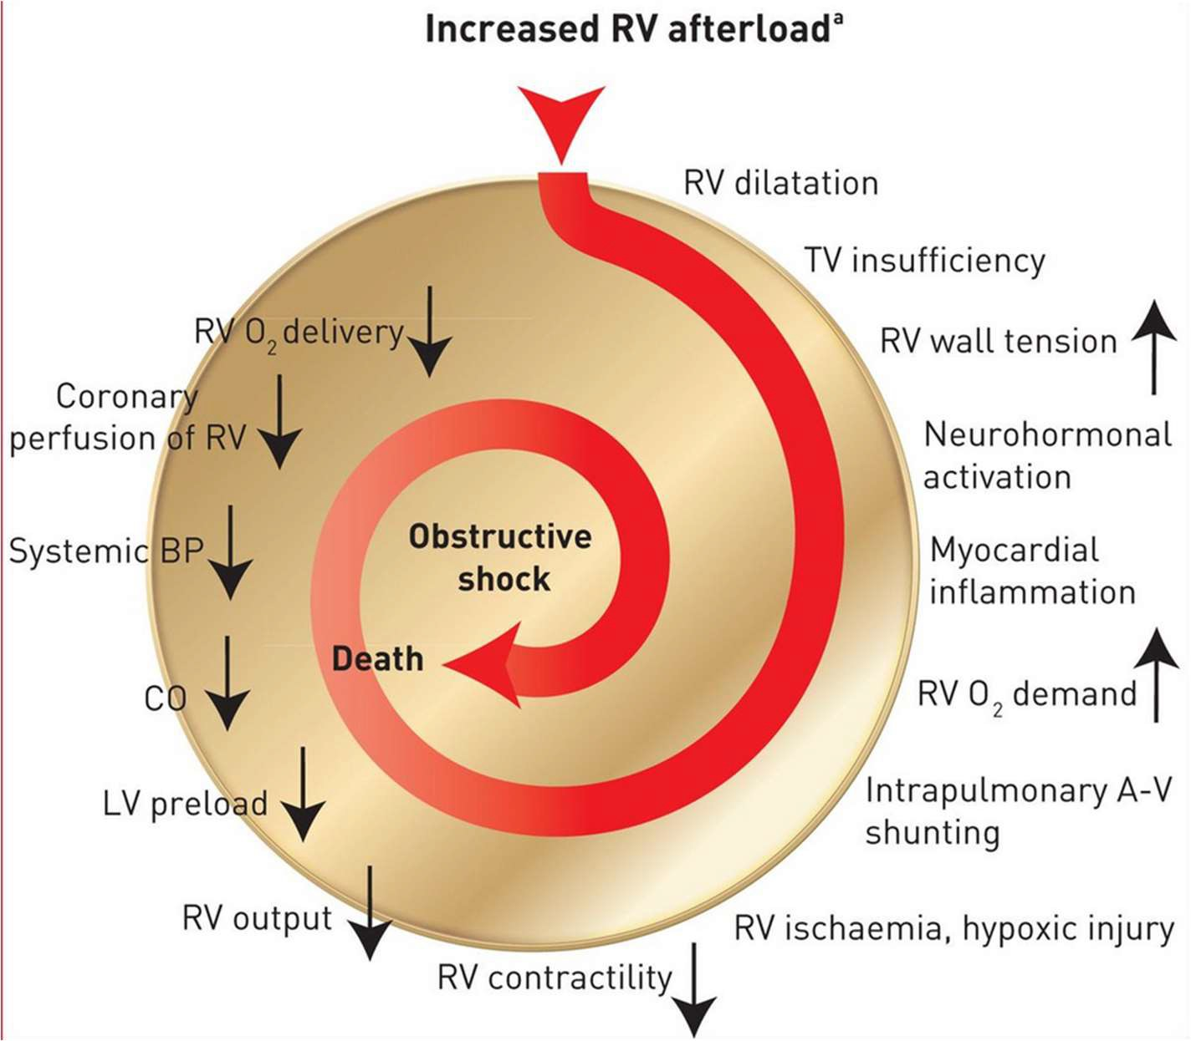

Slide 34
How do we classify???
Patient presents to ER with symptoms of PE +/- DVT
Right ventricular dysfunction?
Low Risk
+ for PE
Risk factors/medical comorbidities (PESI/sPESI score, history of malignancy, history of PE, advanced age)?
CT pulmonary angiogram of the chest
(aka “Cat scan”)
Intermediate Risk
Cardiac biomarkers aka blood tests (troponin and BNP)?
High Risk

Slide 35
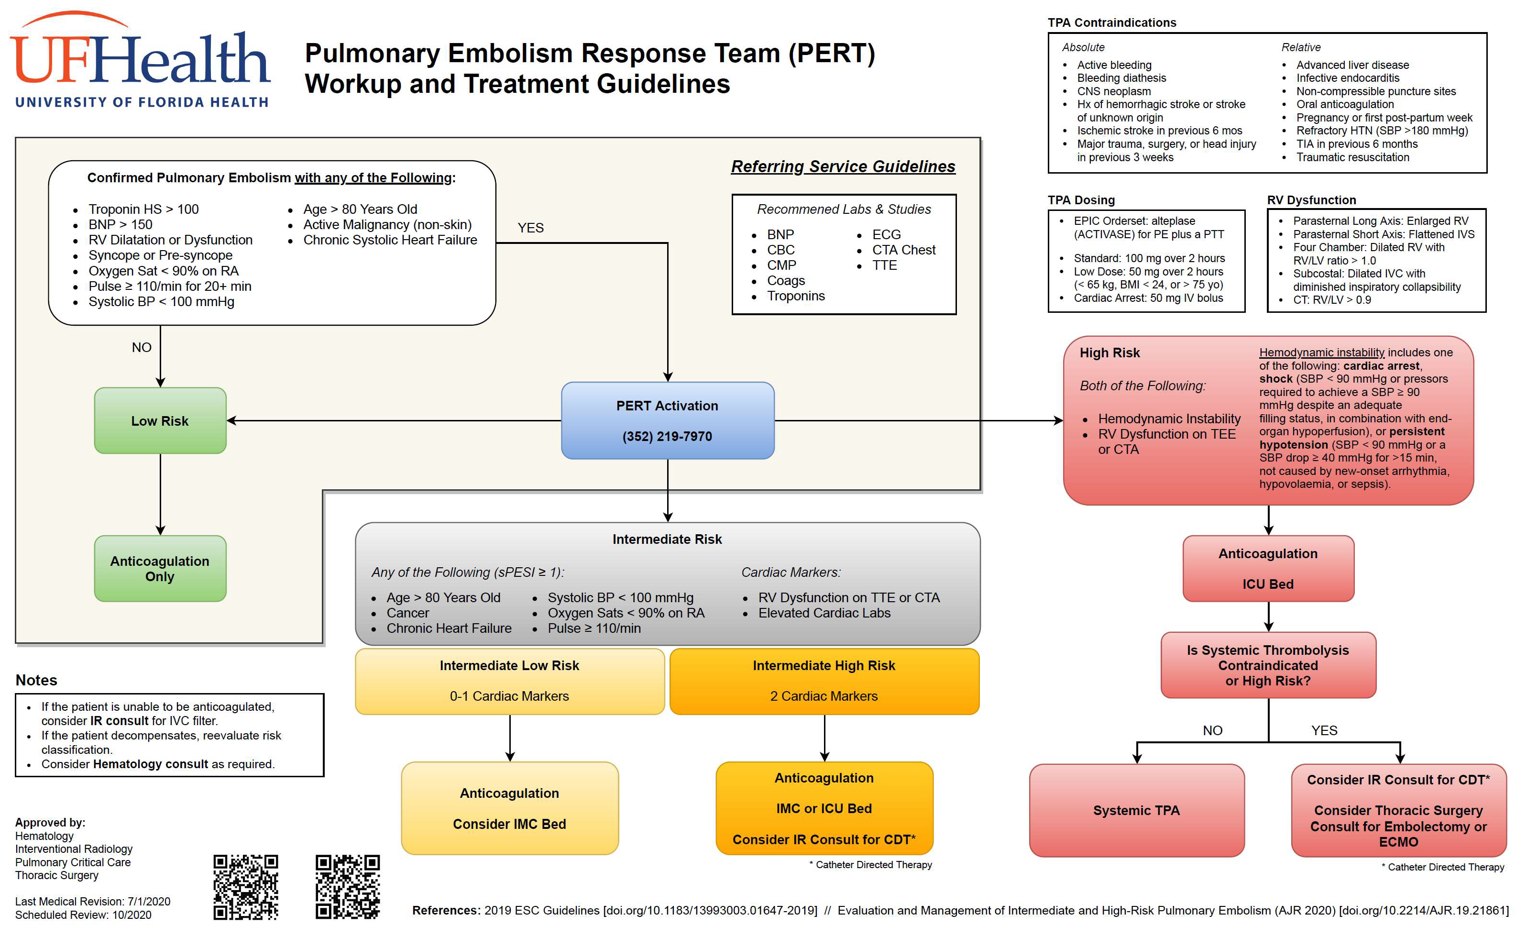

Slide 36
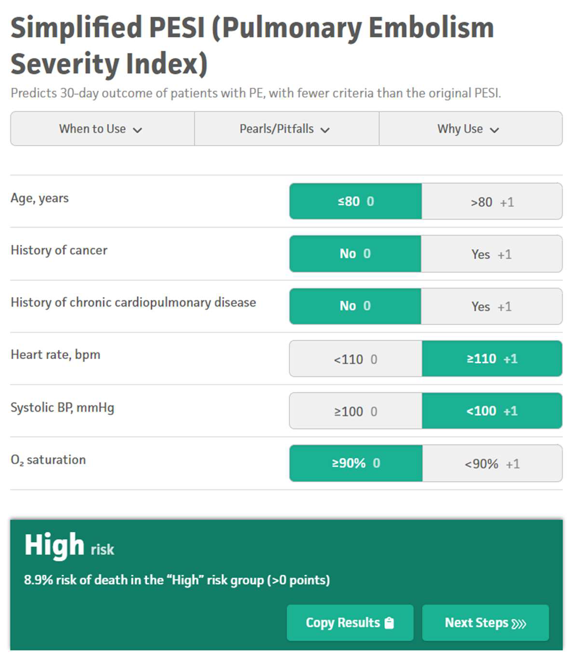
Vital signs at presentation (heart rate, blood pressure, oxygen saturation) and medical history critical in decision tree
*mdcalc.com

Slide 37
Low Risk
Intermediate Risk
High Risk
Stable vital signs Good oxygenation No risk factors
No right heart strain
ANTICOAGULATION (blood thinners)

Slide 38
Low Risk
Intermediate Risk
High Risk
Unstable patient
Systolic blood pressure
<90 mmHg
Vasopressor requirements
Not a candidate for tPA or not
responding to tPA
=
Intervention
Systemic tPA (iv clot dissolving medications)
+
Anticoagulation (blood thinners)

Slide 39
Low Risk
Intermediate Risk
High Risk
Evidence of right heart strain on imaging
Negative cardiac biomarkers Low risk factor assessment
Positive cardiac biomarkers High risk factor assessment
Intermediate LOW risk
ANTICOAGULATION (blood thinners)
Subject of ongoing trials***
patients MAY derive short and long term benefits from early intervention

Slide 40
Low Risk
Intermediate Risk
High Risk
Negative cardiac biomarkers Low risk factor assessment
Positive cardiac biomarkers High risk factor assessment
Intermediate LOW risk
Intermediate HIGH risk
ANTICOAGULATION (blood thinners)
+
INTERVENTION/PROCEDURE
(aka catheter directed therapy, catheter directed thrombolysis, thrombectomy)

Slide 41
Low Risk
High Risk
Intermediate Risk
Blood thinners
Clot dissolving medication + blood thinners
Intermediate LOW risk
Intermediate HIGH risk
ANTICOAGULATION (blood thinners)
ANTICOAGULATION (blood thinners)
+
INTERVENTION/PROCEDURE
(aka catheter directed therapy, catheter directed thrombolysis, thrombectomy)
Subject of ongoing trials***
patients MAY derive short and long term benefits from early intervention

Slide 42
So we have an intermediate high risk PE and we’ve decided to intervene…. What are our options???

Slide 43
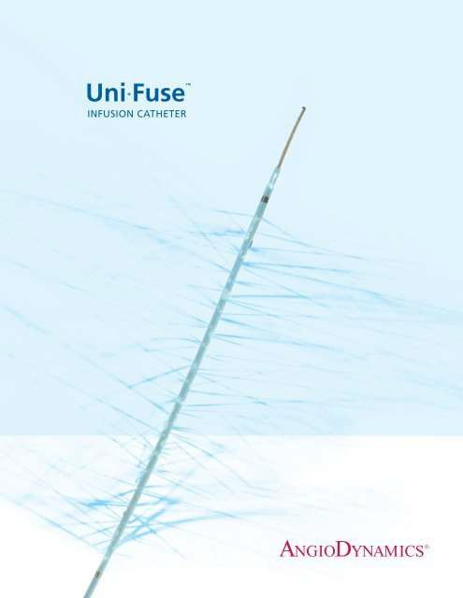
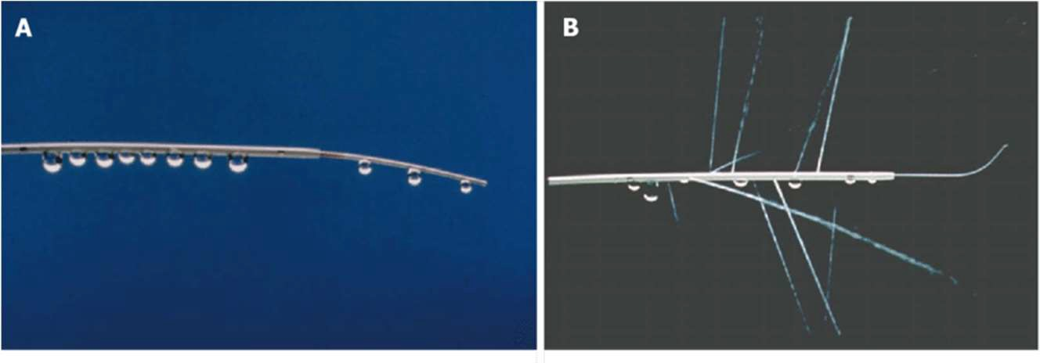
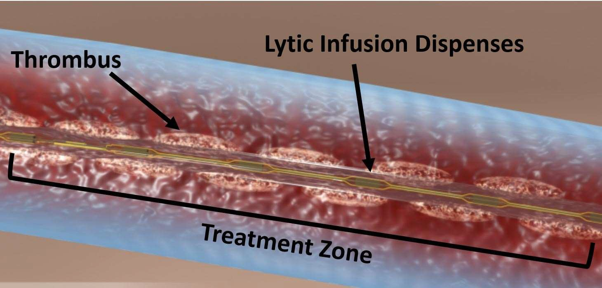
Pharmacologic thrombolysis
Infusion catheters

Slide 44
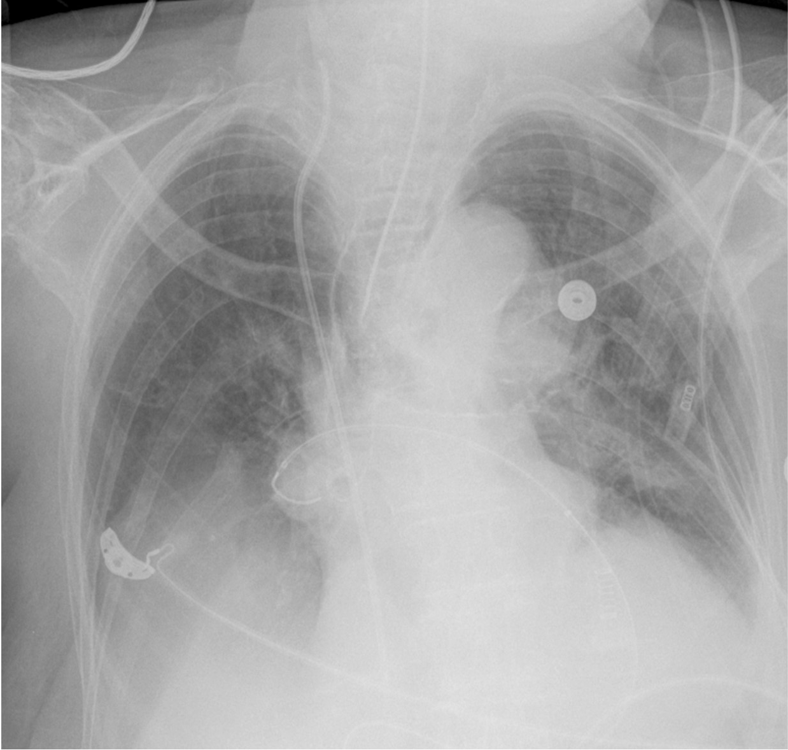
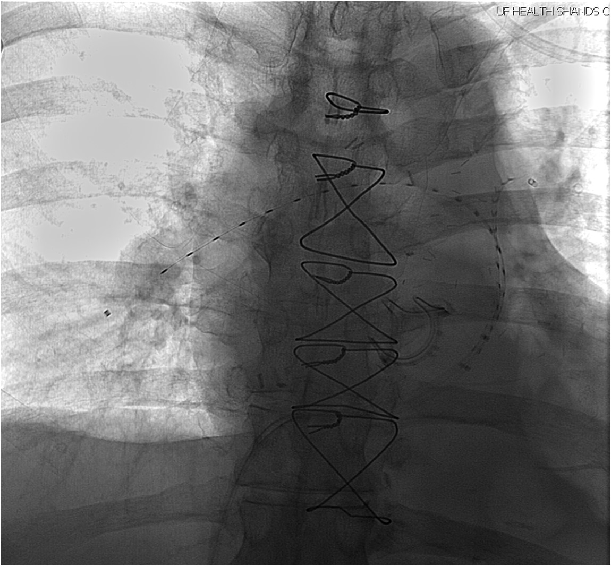

Slide 45
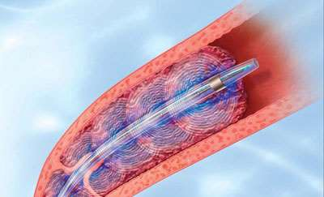
Accelerated catheter directed thrombolysis

Slide 46
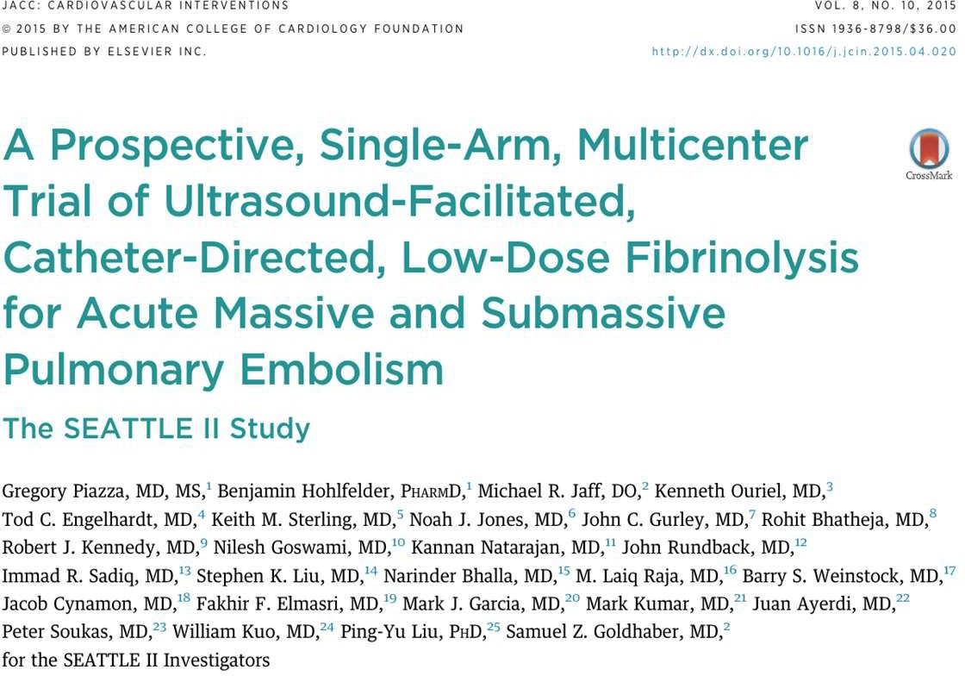
SEATTLE II – Study Design
EKO Safety & Efficacy Trial
Acute Massive and Submassive PE
N=150, 22 centers
S
Piazza G, Hohlfelder B, Jaff MR, et al. A prospective, single-arm, multicenter trial of ultrasound-facilitated, catheter-directed, low-dose fibrinolysis for acute massive and submassive pulmonary embolism: the SEATTLE II study. JACC Cardiovasc Interv. 2015 Aug 24;9(10):1382–1392. doi:10.1016/j.jcin.2015.04.020.

Slide 47
SEATTLE II – Results
Ultrasound thrombolysis was safe and effective in the treatment of pulmonary embolism, but has a 10% major bleed rate
 |  | SEATTLE ll (N=150)
 | Primary Efficacy (reduction in RV/LV ratio at 48 hours) | 0.42, p <0.0001
 | Primary Safety | Major bleeding within 72 hours: 10%
 | Major Bleeding | Within 72 hours: 10%
 | All Cause Mortality (30 days) | 2.7%
 | Device Time | 12 or 24 hours
Piazza G, Hohlfelder B, Jaff MR, et al. A prospective, single-arm, multicenter trial of ultrasound-facilitated, catheter-directed, low-dose fibrinolysis for acute massive and submassive pulmonary embolism: the SEATTLE II study. JACC Cardiovasc Interv. 2015 Aug 24;9(10):1382–1392. doi:10.1016/j.jcin.2015.04.020.

Slide 48
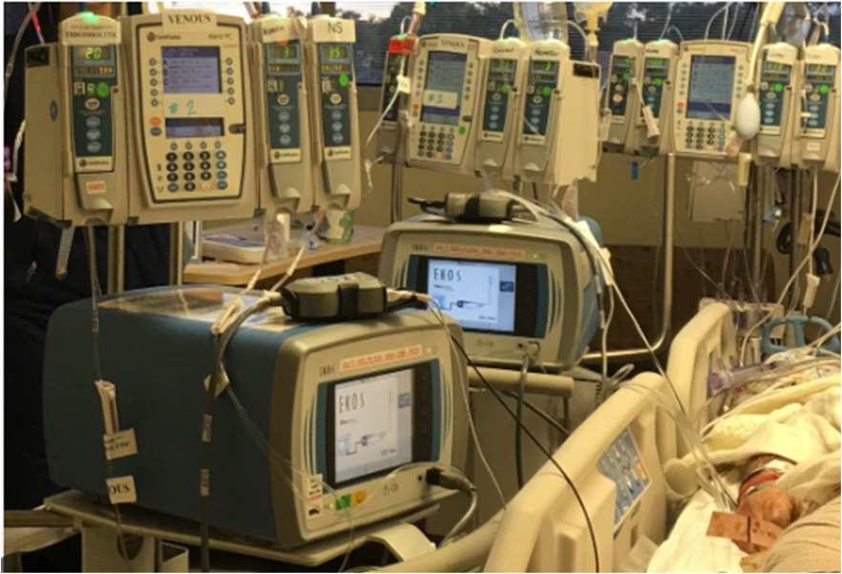
Downsides to tPA
ICU admission (expensive)
Multiple procedures (time consuming)
Complicated ICU management (3 drips plus
EKOS machine PER side)
Bilateral EKOS = 8 new screens to watch/adjust for the ICU nurse…
For example… ICU bed $4,300 per day
In SEATTLE II trial the mean ICU stay was 4.7 days if no major bleeding and 6.8 days with major bleeding = $20,000-30,000

Slide 49
Recent paradigm shift with PE management
Single session treatment
Rapid restoration of pulmonary blood flow leading to:
On table lowering of PA pressures
Increased intraprocedural O2 saturation
Decreasing right heart strain
Eliminate the potential risks with tPA
Decreasing ICU LOS and utilization

Slide 50
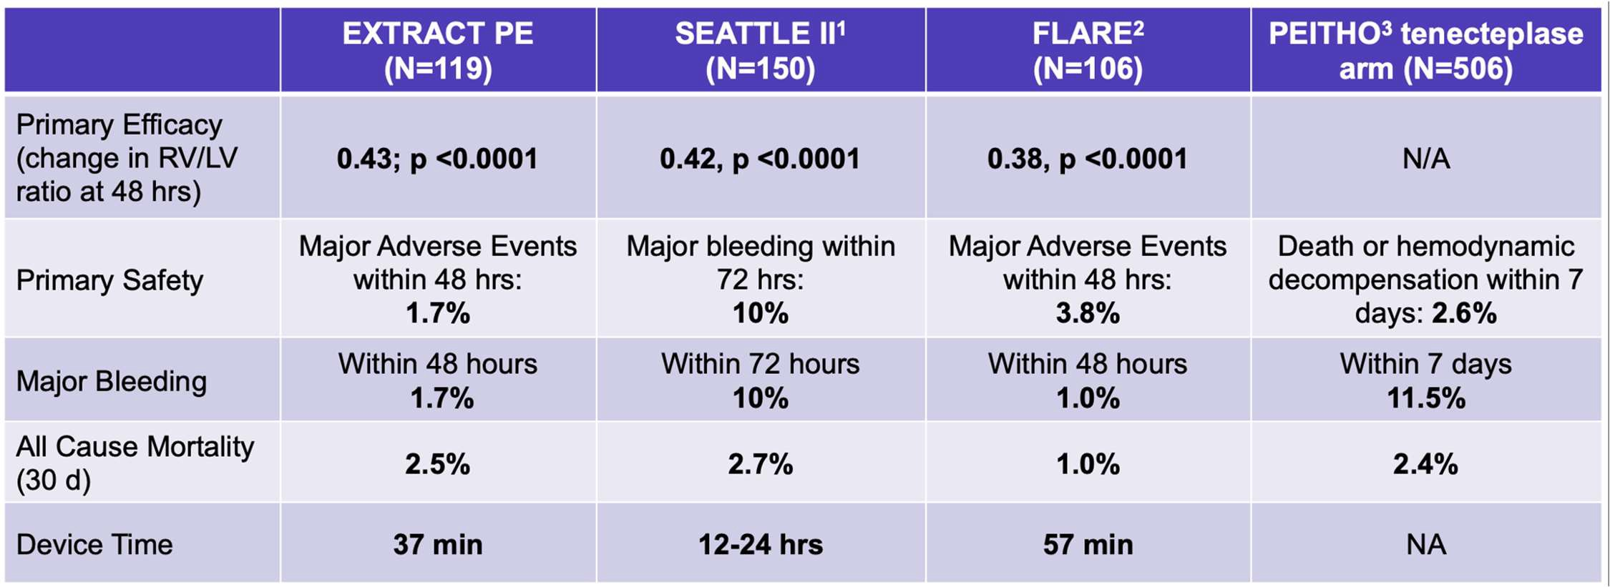

Slide 51
 | Primary Efficacy (change in RV/LV ratio at 48 hrs) | Safety | Major Bleedingª | All-Cause Mortality (30 days) |  | Device Time | Hospital Length of Stay (Days (± SD)) | PE Recurrence Rate (30 days)
EXTRACT-PE¹ (N=119) Indigo System Penumbra® | 27.3% |  |  | 2.5% |  | 37 min (median) | 3.7 ± 2.5 | 0%
 |  | MAE 1.7%^{b} | Within 48 hrs: 1.7%
STRIKE-PE (N = 150) Indigo System Penumbra® | 25.7% | MAE 2.7% | 2.7% | N/A |  | 24.5min N=42 Flash subgroup 33.5 min N=150 subgroup | N/A | N/A
SEATTLE ll³ (N=150) EkoSonic Endovascular System | 24%^{d} | Major Bleeding within 72 hrs: 10% | Within 72 hrs: 10% |  | 2.7% | 12–24 hrs | 8.8 ± 5 | N/A
REAL-PE⁷ MT Inari vs EKOS | - | IC Hemorrhage 4.9% vs 5.3% | 17.3% Inari 12.4 % EKOS | 3.5% Inari 2.3% EKOS (not statistically significant) |  | - | 3.6 both groups | 5.3 vs 4.9 % readmission rate
FLASH⁴ (N=788) FlowTriever Inari Medical® | 23% | MAE 1.8% | Within 48 hrs: 1.3% | 0.8% |  | 43 min | 3 | N/A
FLAME⁵ (High Risk PE) (N=53) FlowTriever Inari Medical® | N/A | Device Related Complications 22.6% MAE 17.0% | 11.3% | In Hospital Mortality 1.9% |  | N/A | 7 | N/A
1.
2.
3.
4.
5.
6.
7.
Sista AK, et al. Indigo aspiration system for treatment of pulmonary embolism: results of the EXTRACT-PE trial. JACC Cardiovasc Interv. 2021 Feb 8;14(3):319–329.
Tu T, et al. A prospective, single-arm, multicenter trial of catheter-directed mechanical thrombectomy for intermediate-risk acute pulmonary embolism: the FLARE study. JACC Cardiovasc Interv. 2019 May 13;12(9): 859–869.
Piazza G et al. A prospective, single-arm, multicenter trial of ultrasound-facilitated, catheter-directed, low-dose fibrinolysis for acute massive and submassive pulmonary embolism: the SEATTLE II study. JACC Cardiovasc Interv. 2015 Aug 24;9(10):1382–1392.
Toma C, et al. Acute outcomes for the full US cohort of the FLASH mechanical thrombectomy registry in pulmonary embolism. Eurointervention. 2023 Feb 20;18(14):1201-1212.
Silver MJ, et al. Outcomes in High-risk Pulmonary Embolism Patients Undergoing FlowTriever Mechanical Thrombectomy: Results from the FLAME Study
Bashir R, et al. Pharmacomechanical Catheter-Directed Thrombolysis With the Bashir Endovascular Catheter for Acute Pulmonary Embolism: The RESCUE Study. J Am Coll Cardiol Intv 2022; 15:2427-2436.
Monteleone P, et al. Modern Treatment of Pulmonary Embolism (USCDT versus MT): Results from Real-World, Big Data Analysis (REAL-PE). Journal of the Society for Cardiovascular Angiography & Interventions; Oct 2023.

Slide 52
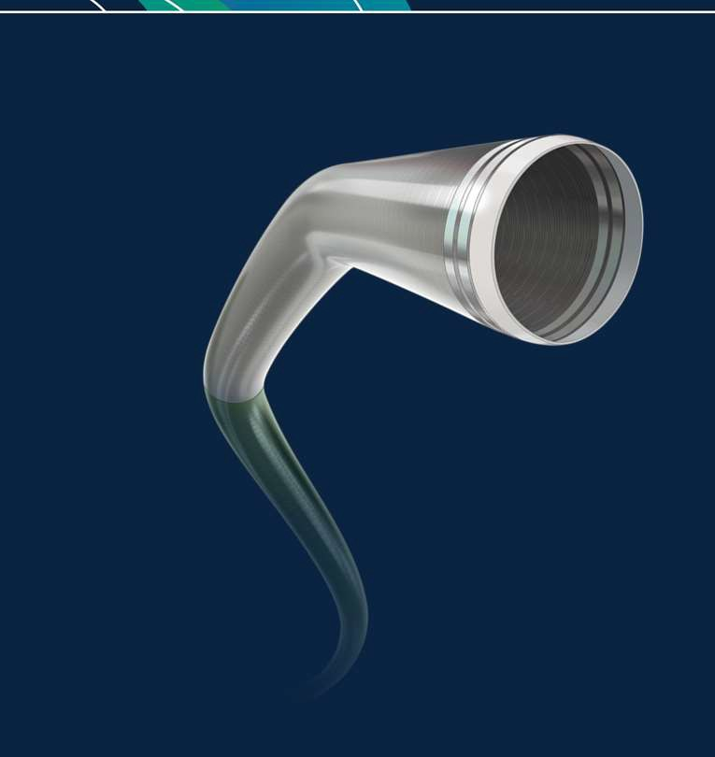
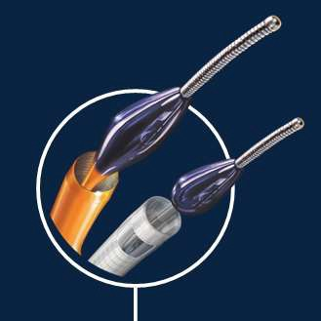
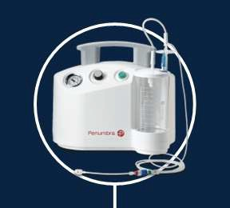
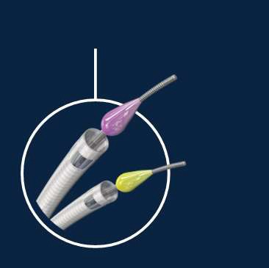
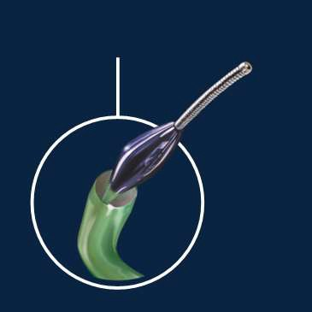
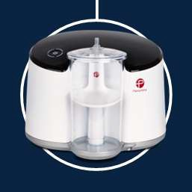
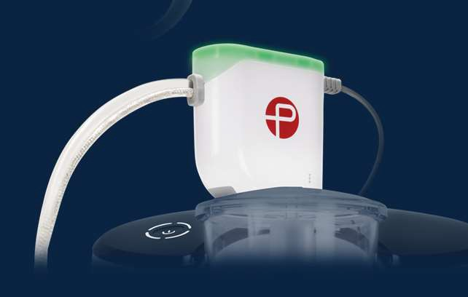
CA 5 & CAT3
CATD
Penumbra ENGINE
T
2013
2014
2015
2017
2018
2019
2020
Pump MA
X
CAT8 & CAT6
CAT RX
Lightning & CAT12
As part of the Indigo Aspiration System, the Indigo CAT RX Aspiration Catheters and Indigo Separat 4 are indicated for the removal of fresh, soft emboli and thrombi from vessels in the coronary and peripheral vasculature.
or
Caution: Federal (USA) law restricts these devices to sale by or on the order of a physician. Prior to use, please refer to the Instructions for Use for complete product indications, contraindications, warnings, precautions, potential adverse events, and detailed instructions for use. Please contact your local Penumbra representative for more information. Copyright ©2020 Penumbra, Inc. All rights reserved. The Penumbra P logos, Indigo, Lightning, Penumbra ENGINE, MAX, CAT, Separator, and ACE are registered trademarks or trademarks of Penumbra, Inc. in the USA and other countries. All other trademarks are the property of their respective owners. 18597, Rev. A 07/20 USA
24

Slide 53
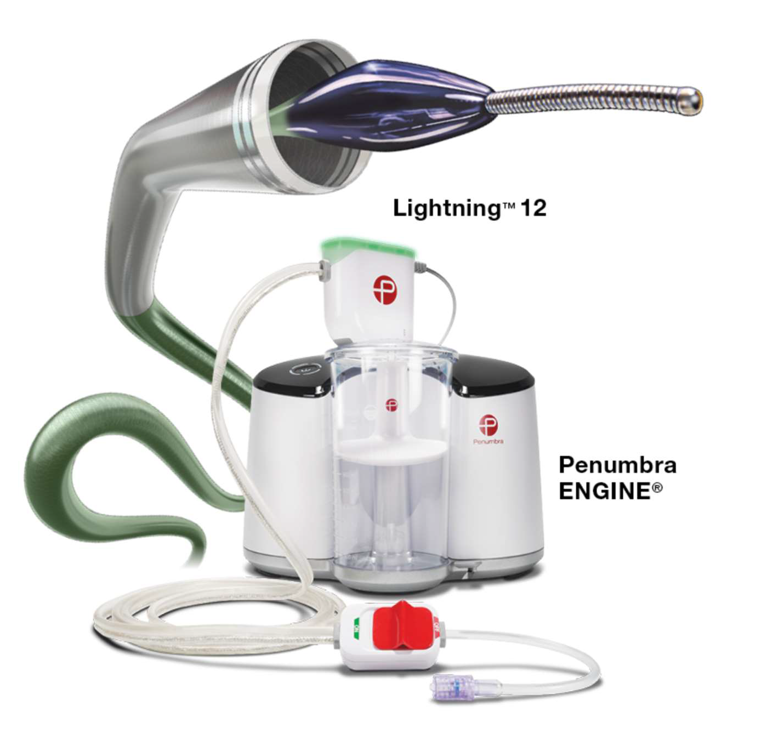
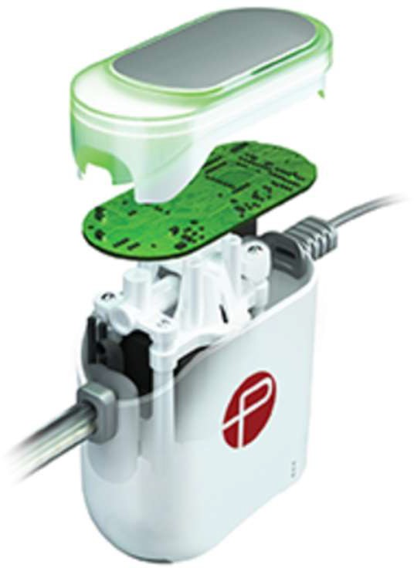
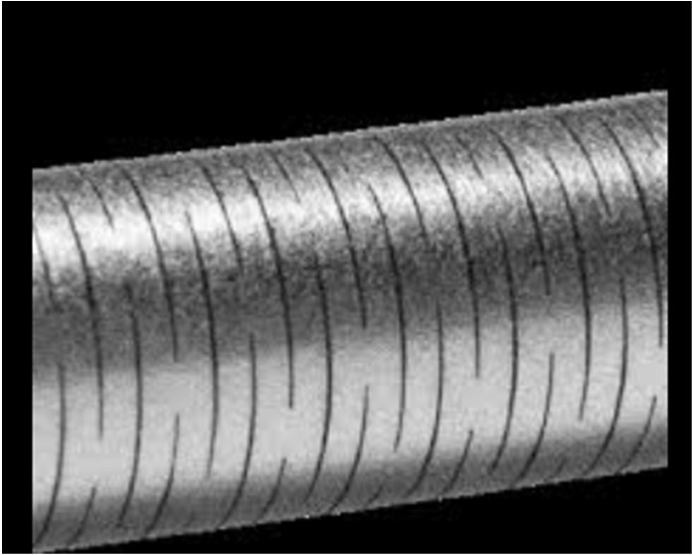

Slide 54
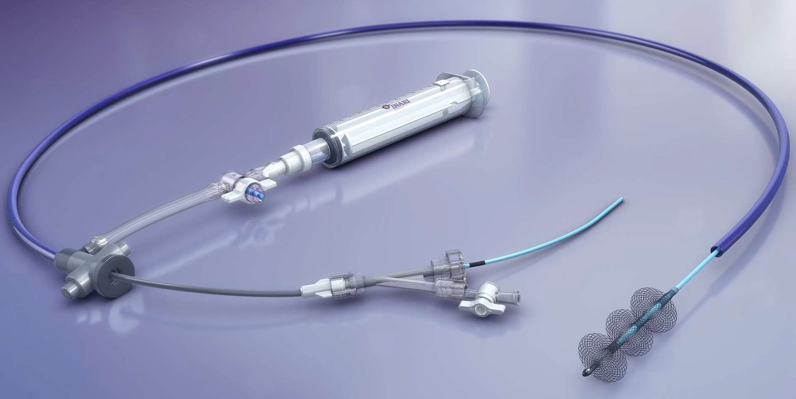

Slide 55
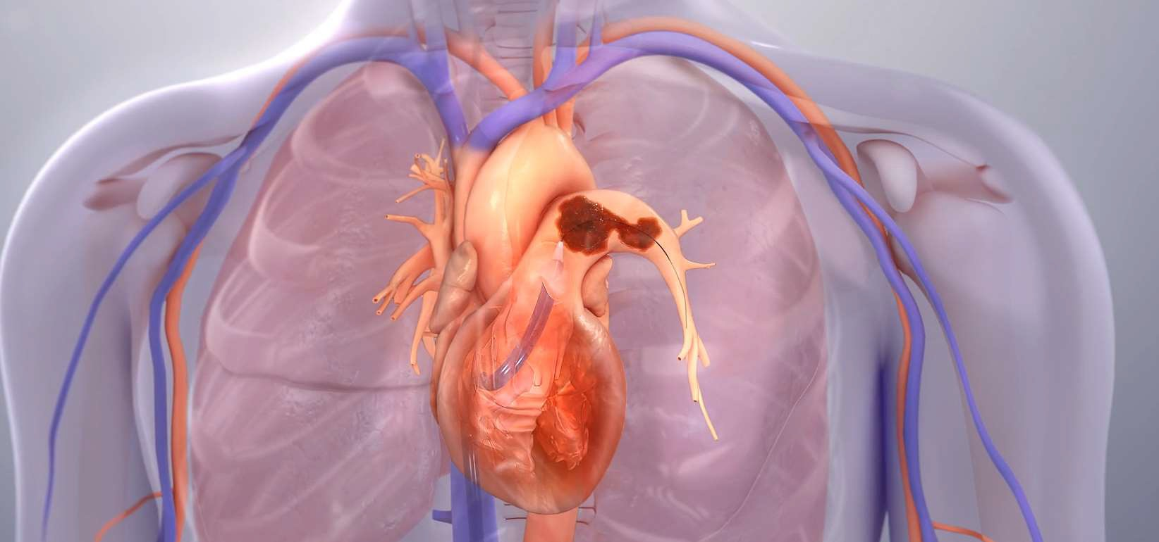

Slide 56
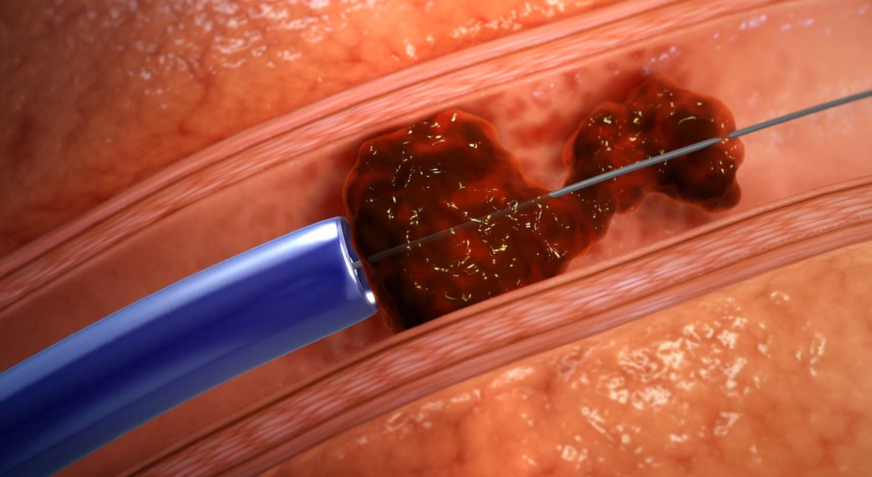

Slide 57
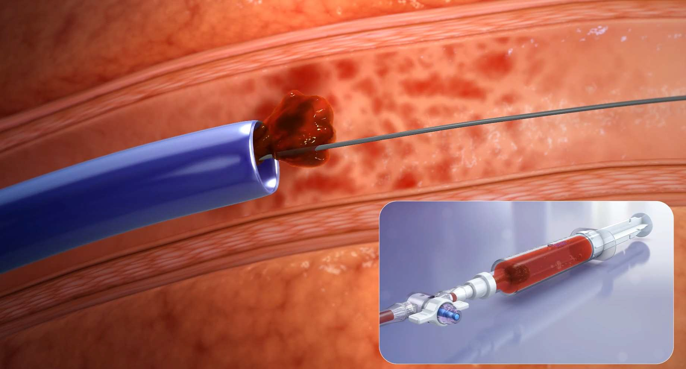

Slide 58
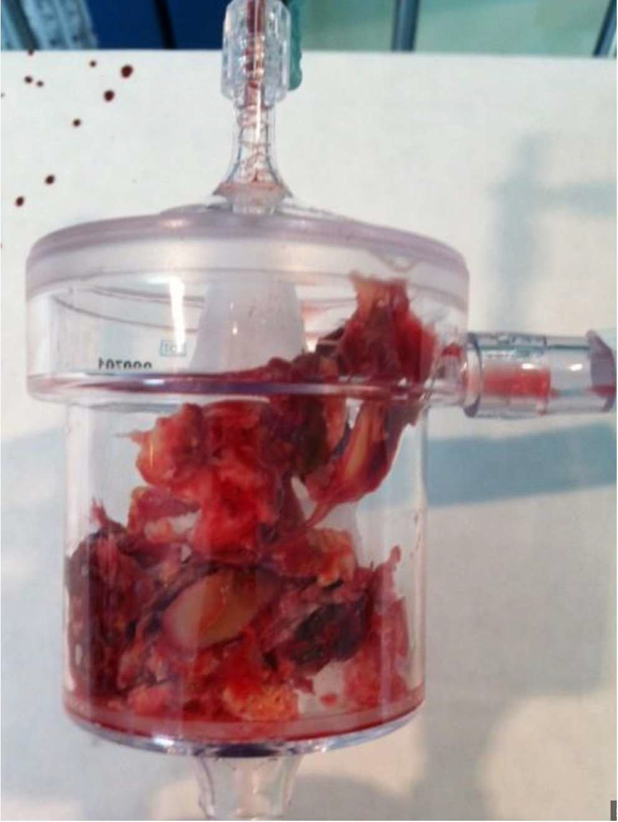
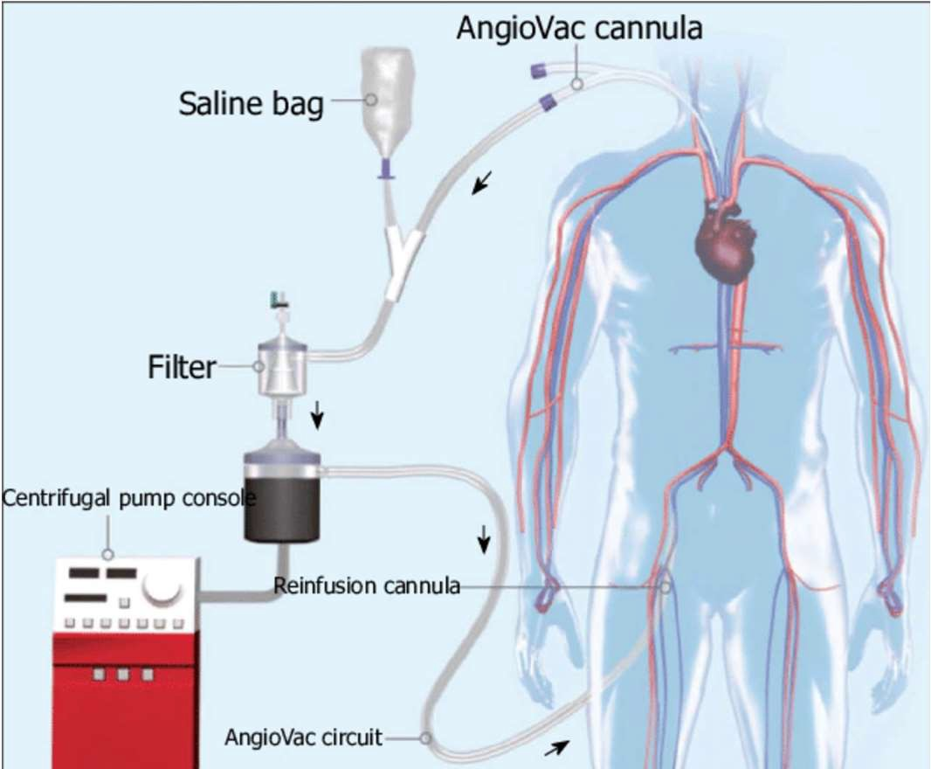
AlphaVac
Angiovac

Slide 59
ALPHAVAC

Slide 60
Other emerging devices but the bottom line remains the same….

Slide 61
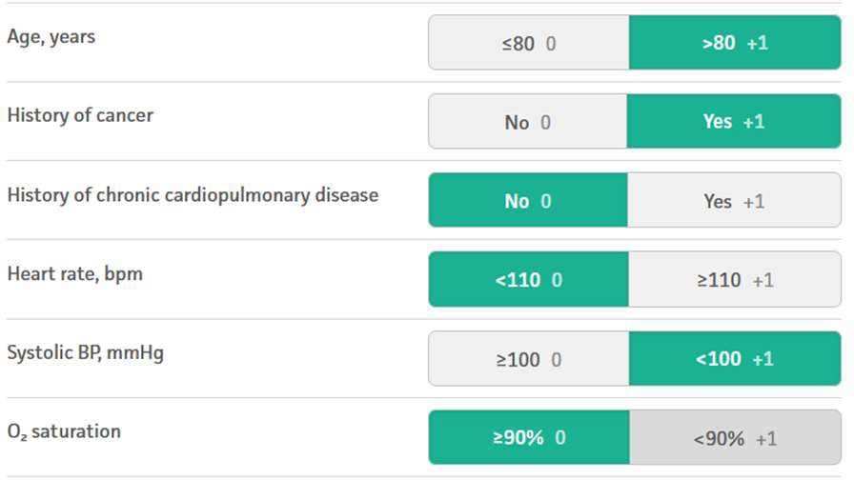
QUICK CASE EXAMPLE
87 yo male with SOB for 2 days, h/o HTN, HLD, prostate cancer*
BP 97/62 HR 91 RR 16 O2 – 96% on 4L NC
CTA revealed “saddle” PE with right heart strain RV/LV ratio 1.4
Trop I HS 4,021 pg/dl
Intermediate HIGH risk patient
ANTICOAGULATION (blood thinners)
+
INTERVENTION/PROCEDURE
(aka catheter directed therapy, catheter directed thrombolysis, thrombectomy)

Slide 62
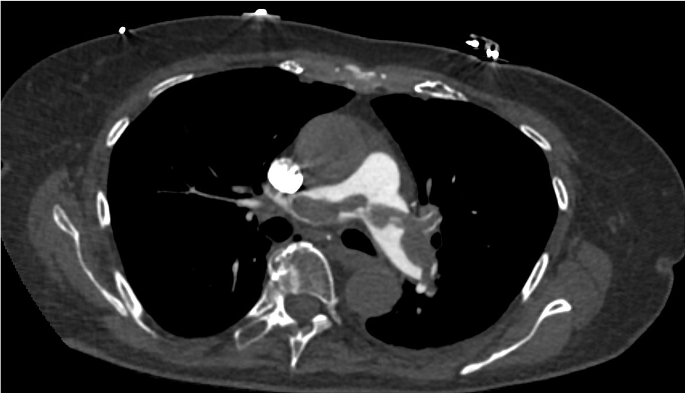
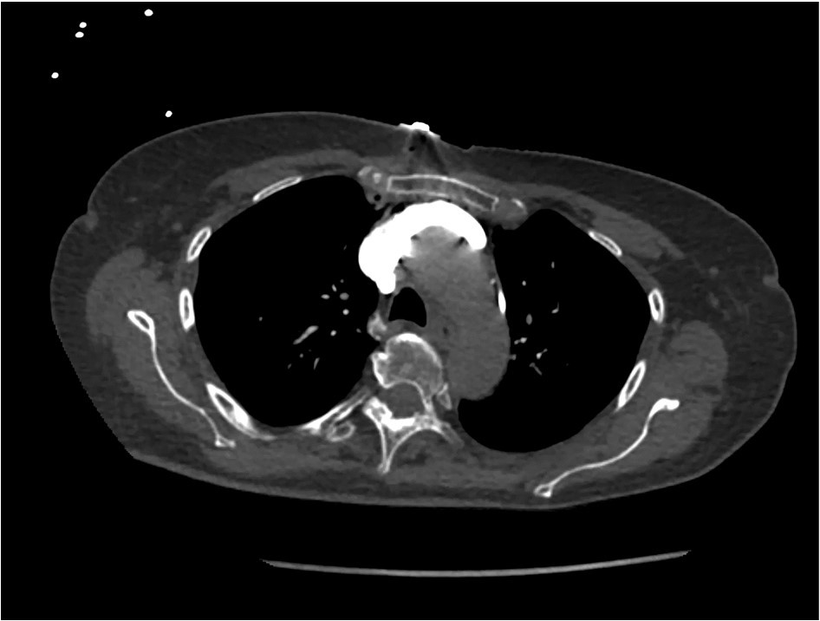

Slide 63
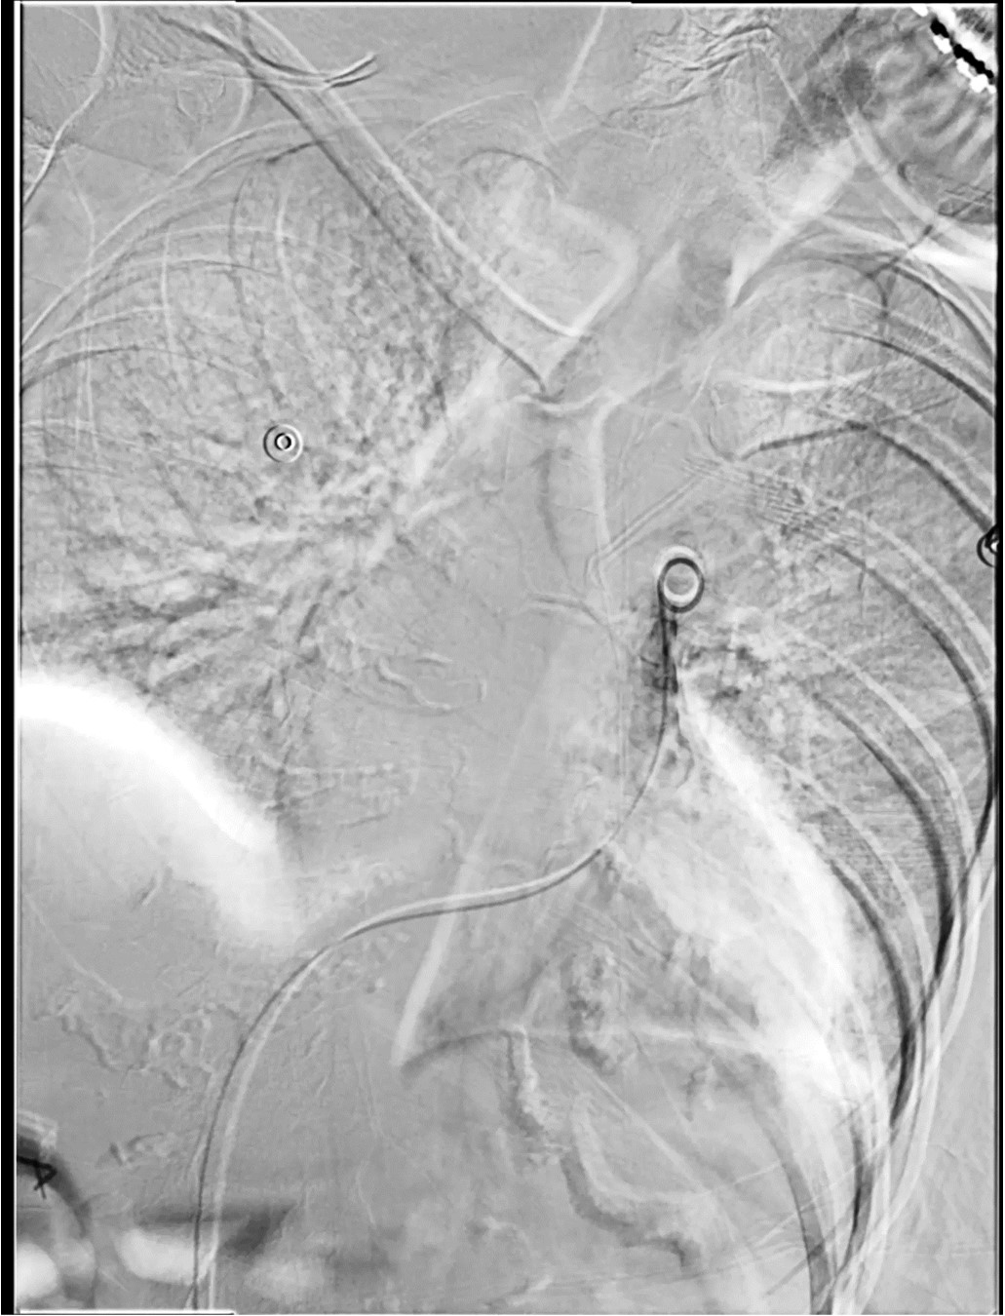
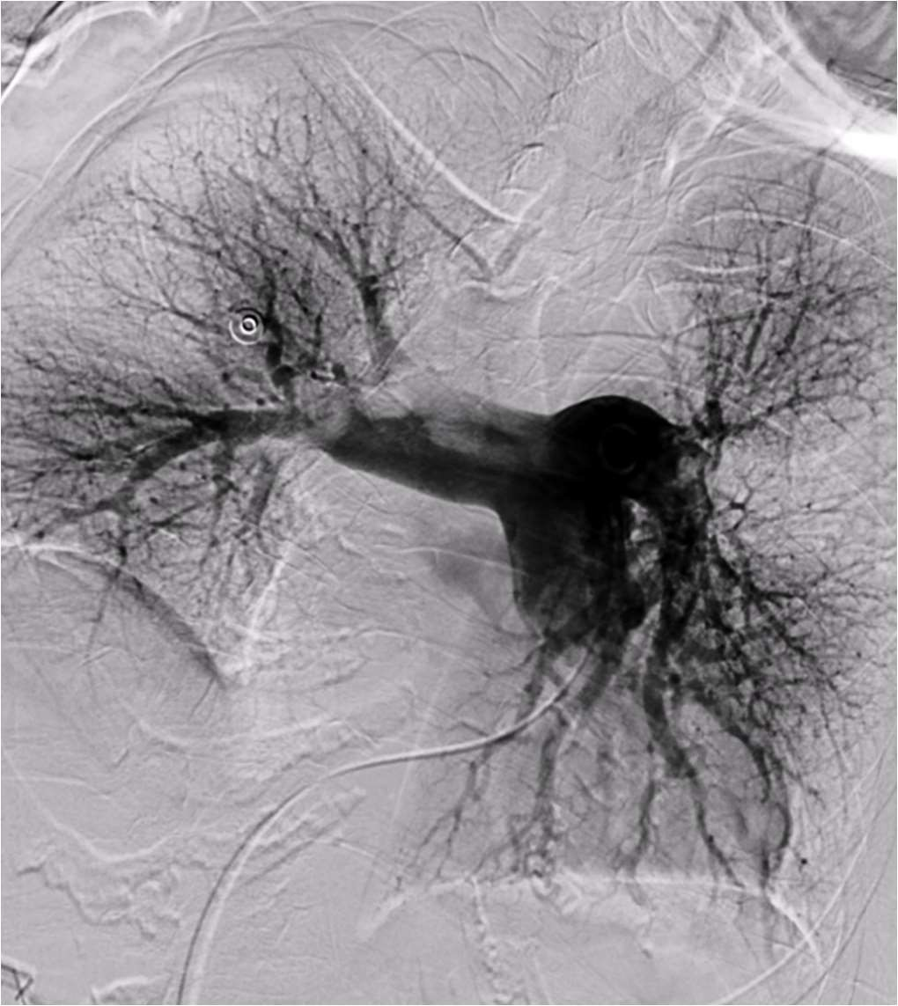

Slide 64
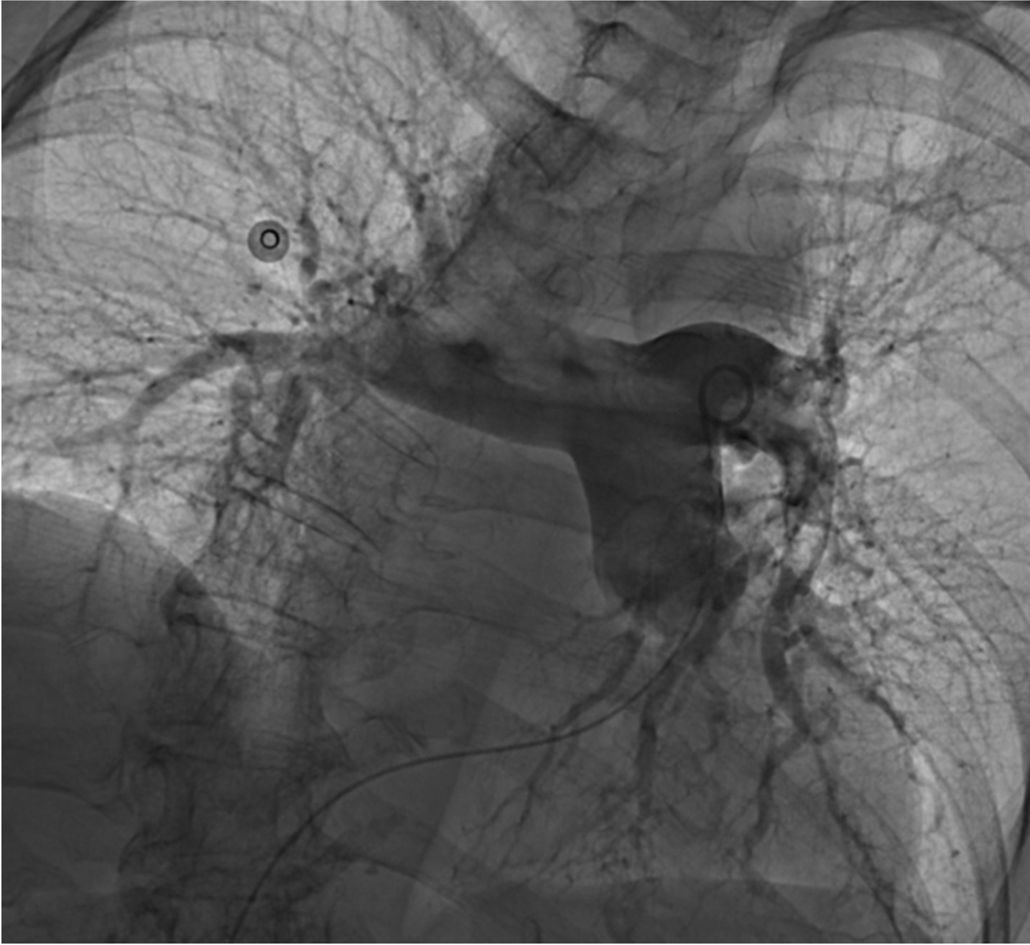

Slide 65
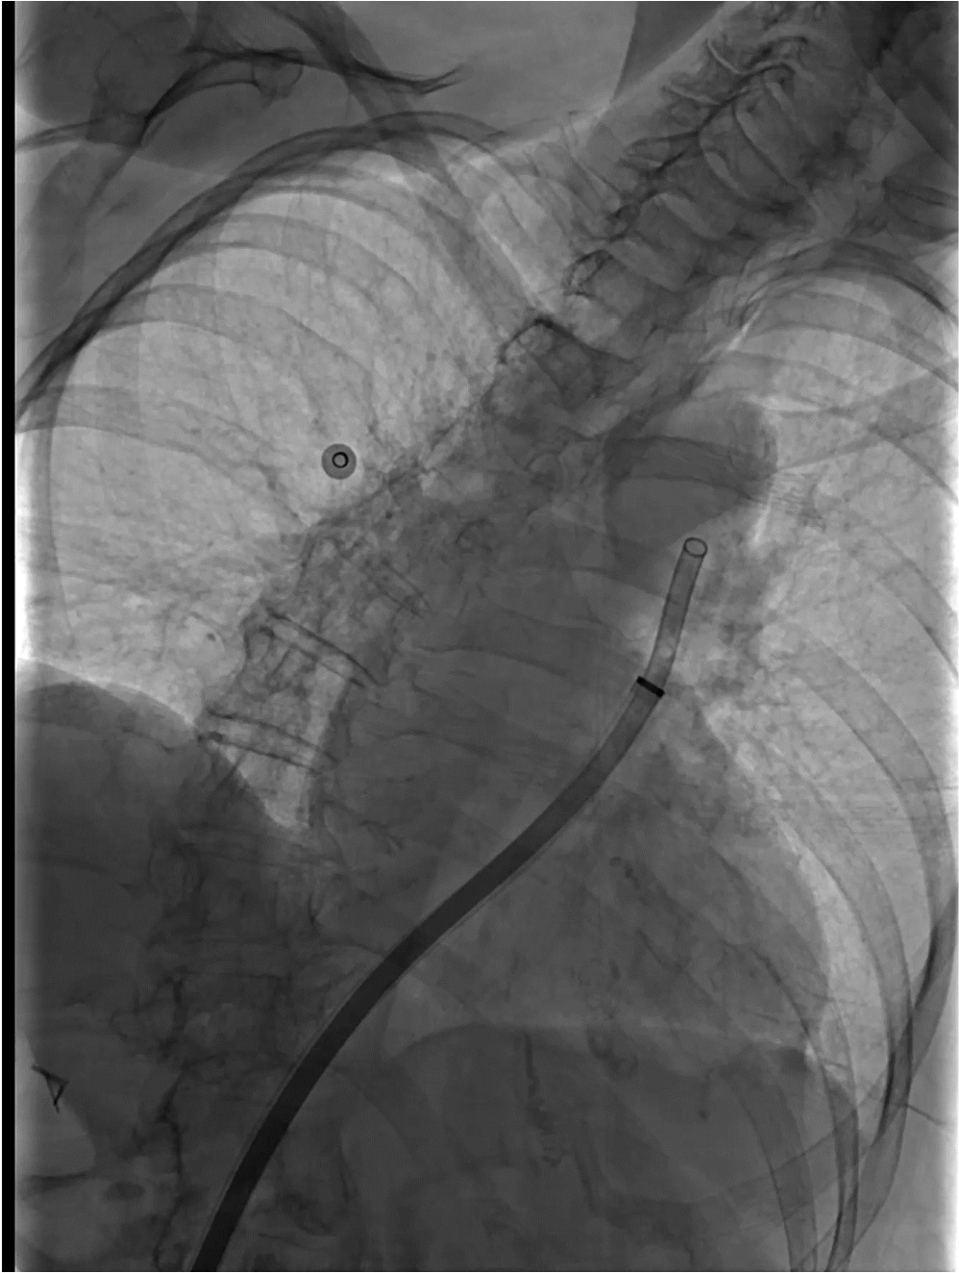
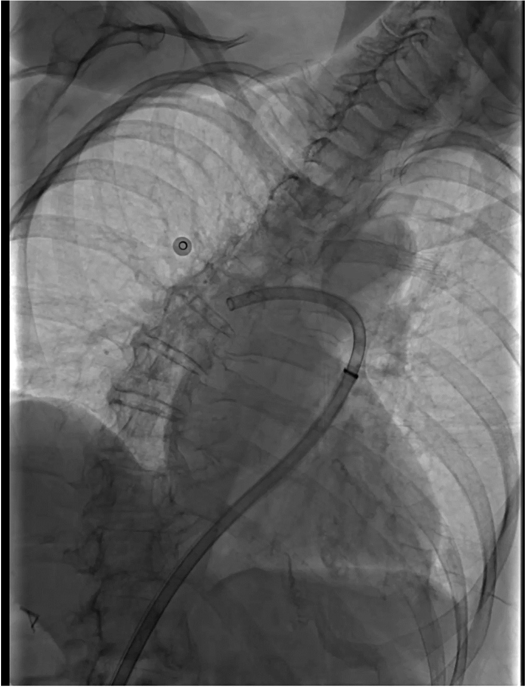

Slide 66
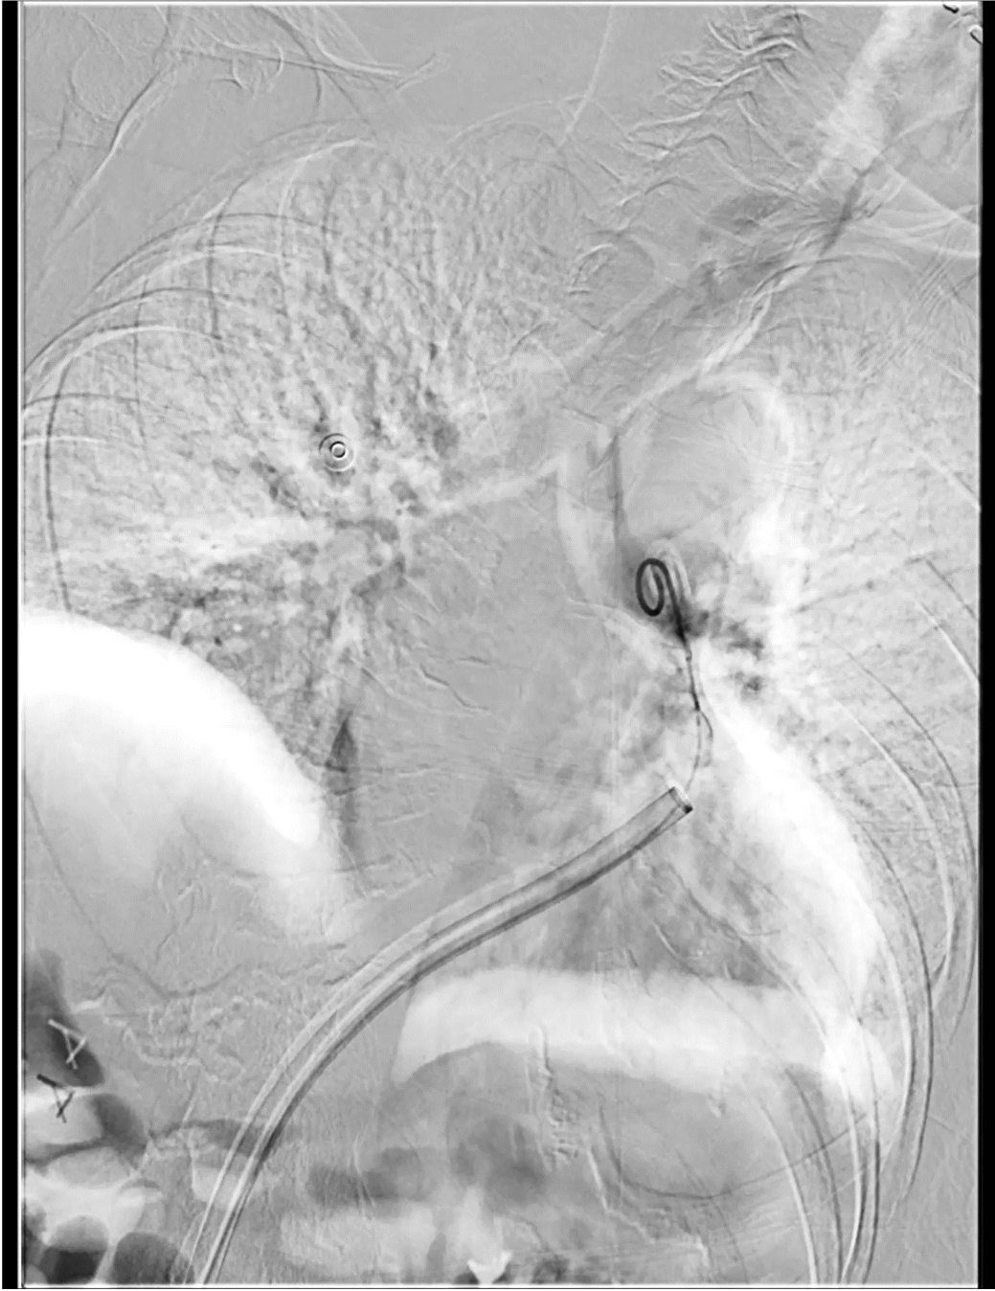

Slide 67
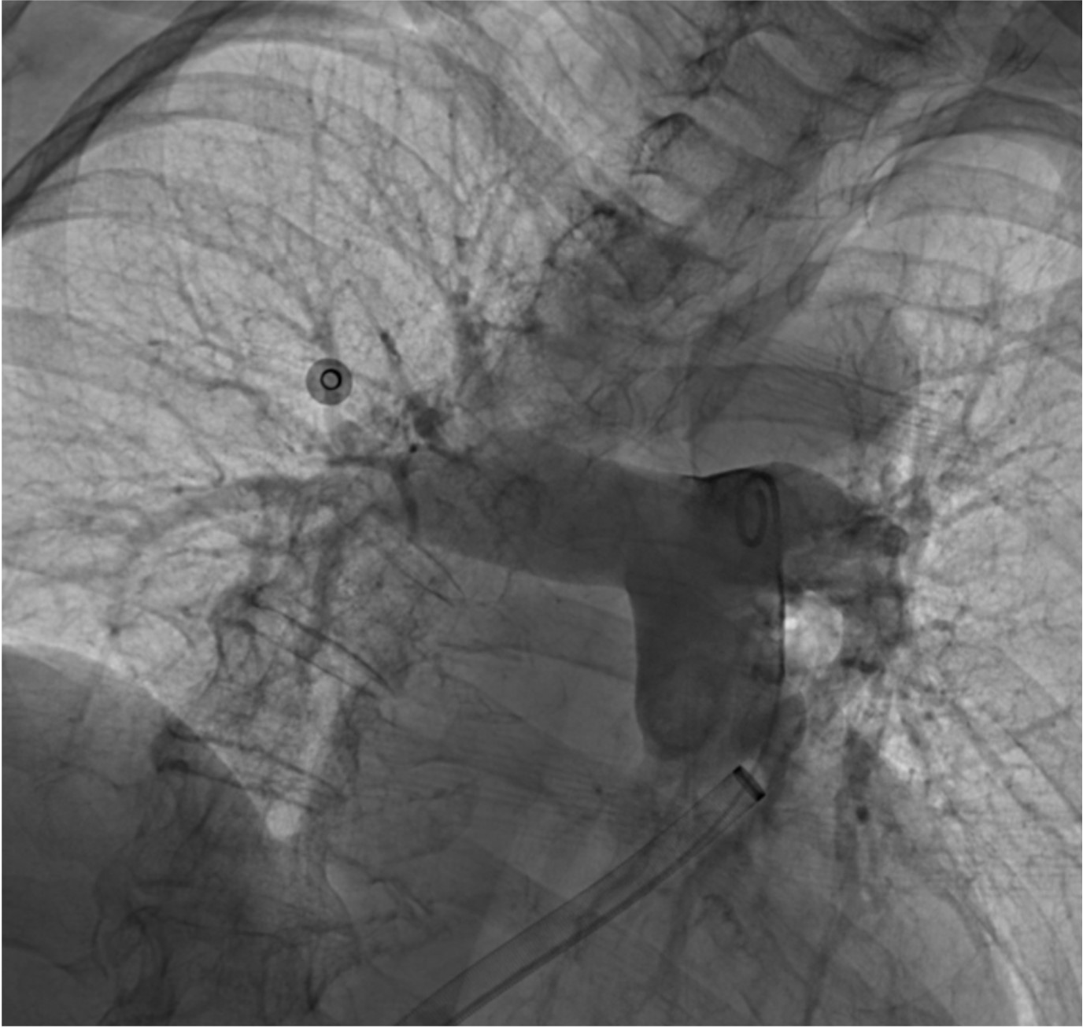
EBL 250 cc
Procedure time 42 min
Thrombectomy time 20 min

Slide 68
Patient was discharge from the hospital 4 days later in stable condition
Patient stated he felt like “an elephant had been lifted off of his chest” after the thrombectomy
What does the next 6 months look like for this patient?
Blood thinners
Follow up with their doctor
“Post PE syndrome” which may include shortness of breath, persistent chest pain, decreased exercise intolerance

Slide 69
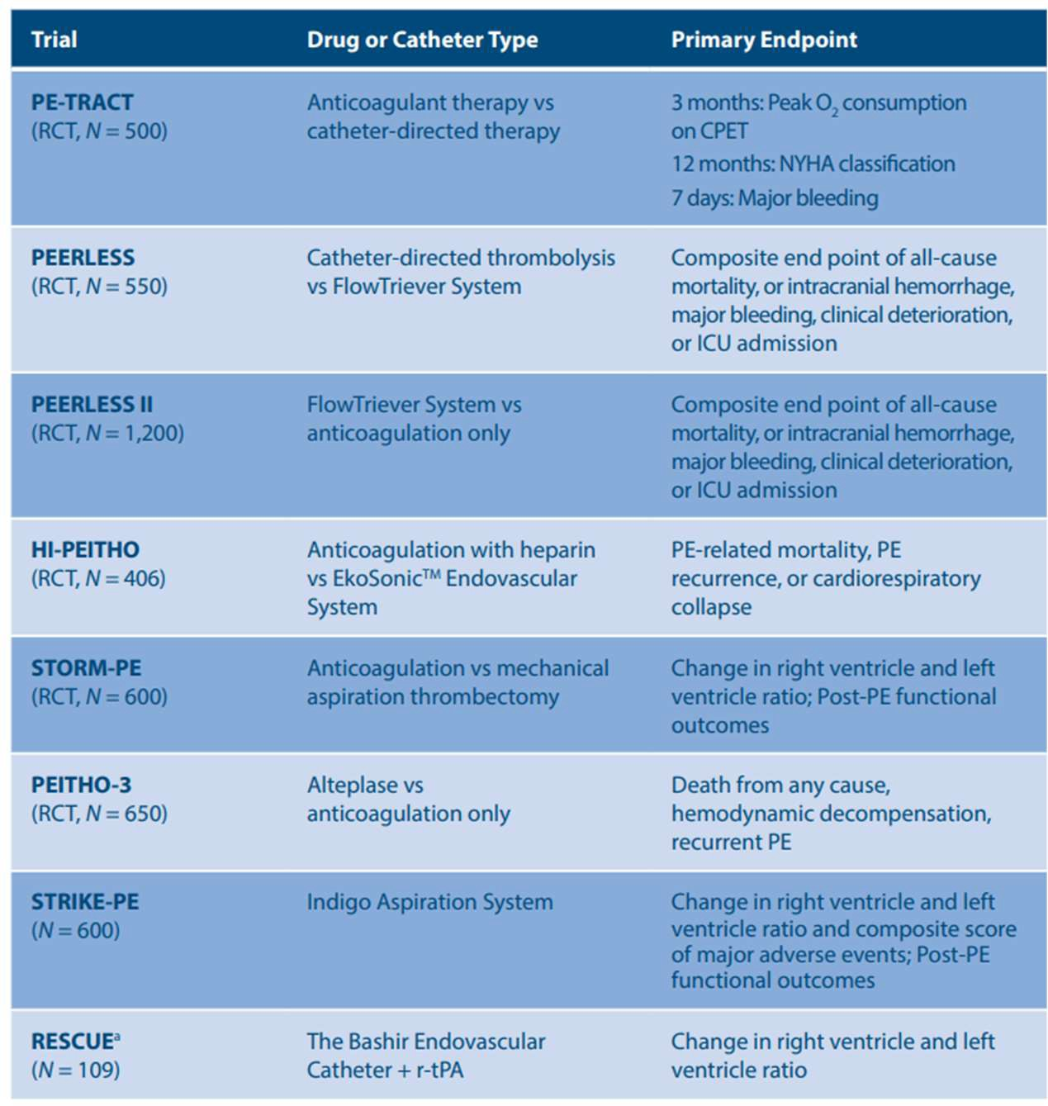
Who should we be treating with Thrombectomy / catheter directed thrombolysis???
A number of clinical trials are actively enrolling patients as we speak
As faculty at UF I was site principle investigator for STRIKE PE study with the highest enrollment INTERNATIONALLY
Incidence of PE is Florida is HIGH, we are seeing it on the front lines
*Chest Physician supplement 2023

Slide 70
Should we start thinking about PE like we think about stroke and heart attack???
Stroke
tPA
Mechanical thrombectomy (aka removing the clot from the brain)
Systemic anticoagulation (blood thinners)
Heart Attack
Percutaneous coronary intervention (aka heart stent)
Blood thinners
+
(clot dissolving medication for actively dying patients)
Pulmonary Embolism
Thrombolysis / Suction Thrombectomy

Slide 71
Questions?
Evans.Heithaus@radpartners.com
Robert Evans Heithaus, MD Vascular & Interventional Radiology

Slide 72
Workgroup Discussion

Slide 73
Public Comments

Slide 74
Meeting Summary

Slide 75
Next Steps

Slide 76
Adjournment

