Slide 1
Blood Clot and Pulmonary Embolism Policy (BCPEP)
June 26, 2024
This meeting is being recorded

Slide 2
Agenda

Slide 3
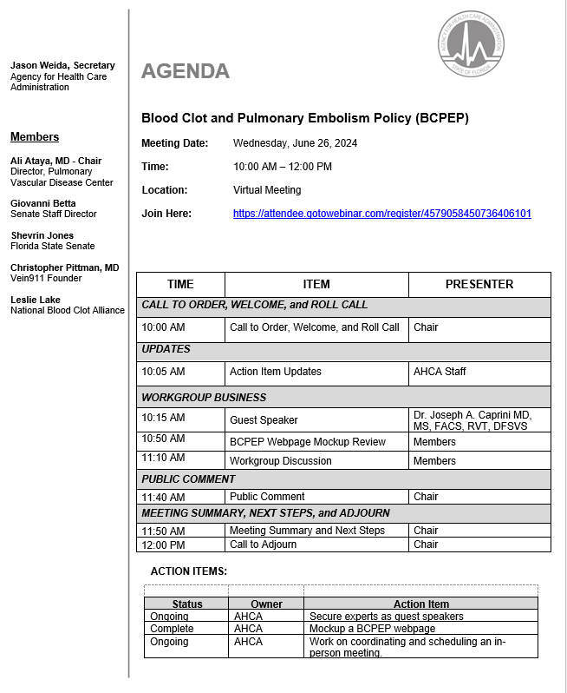

Slide 4
Call to Order, Welcome, and Roll Call

Slide 5
Previous Action Items and Status Updates

Slide 6
Preventing Fatal Pulmonary Emboli: The Missing Link
Blood Clot And Pulmonary Embolism Policy Workgroup June 26th, 2024
Joseph A. Caprini, MD, MS, FACS, RVT, DFSVS
Emeritus, NorthShore University Health System, Evanston, IL
Past Senior Clinician Educator, Pritzker School of Medicine, Chicago, IL

Slide 7
Disclosures
Sanofi - Honoraria
Recovery Force-Consultant
Arjo, Inc. Honoraria
Janssen – Honoraria
Aspen Healthcare - Honoraria
I do not anticipate discussing the unapproved/investigative use of a commercial product/device during this presentation

Slide 8
Fatal PE Is The Leading Cause Of Death Postoperatively
PE mortality has increased over the past decade
J Am Heart Assoc. 2020;0:e016784. DOI: 10.1161/JAHA.120.016784
WHY

Slide 9
We Have Enough Data And The Algorithm To Prevent The Majority Of These Deaths

Slide 10
The Data

Slide 11
Fatal Pulmonary Embolism In Surgical Patients
Randomized double-blind comparison of LMWH with UFH, involving 23,078 surgical patients
Outcome | LMWH (N = 11,542) N (%) | UFH (N = 11,536) N (%) | p
PE (at autopsy) | 22 (0.191) | 22 (0.191)
Fatal | 17 (0.147) | 18 (0.156) | 0.87
Non-fatal | 5 (0.043) | 4 (0.035) | 1
All Patients Received At Least 7 days Of Anticoagulant Prophylaxis
Anticoagulant prophylaxis reduces the risk of death to 0.15%
No deaths from anticoagulant bleeding
occurred in this large series
Haas S, et al. Thromb Haemost. 2005;94:814-9.

Slide 12
Length of Anticoagulant Prophylaxis
From 1975 to 2005
43,000 patients (160 centers)
Objective diagnostic endpoints
ANTICOAGULANT PROPHYLAXIS FOR ONE WEEK ESTABLISHED EFFICACY
Kakkar VV, et al. Lancet. 1975;2:45-51
Collins R, et al. N Engl J Med. 1988;318:1162-73
Haas S, et al. Thromb Haemost. 2005;94:814-9

Slide 13
Risk Assessment Tool Outlining Evidence-based Guidelines

Slide 14
Caprini Score
Thorough history and physical (40 elements)
Power of each risk factor graded regarding VTE incidence
Combination of number of risk factors and their relative weights results in a score
Non-linear increase in clinical VTE rate with increasing score
100
100
80
60
50
40
36
DVT
Rate
24
20
11
0
1
2
3
4
5
Number of Risk Factors
General Surgery
Caprini Score Has Been Validated In About 5,000,000 Patients Including 397 PUBMED Listings as of (6-15-2024)

Slide 15
Thrombosis Risk
Patient A
Age 42 years =1 point
BMI 29 = 1 point
Birth control pills = 1 point
Caprini Score 3 Moderate Risk
Patient B
Age 76 years = 3 points
History of PE = 3 points
Past cancer = 2 points
Caprini Score 8 High Risk
Although each patient has 3 risk factors, the combination of NUMBER of risk factors and their POWER result in a more accurate estimate of VTE risk compared to a simple list of risk factors alone

Slide 16
The Forgotten Duo!
Frequently Not Collected By Caprini Risk Score Users

Slide 17
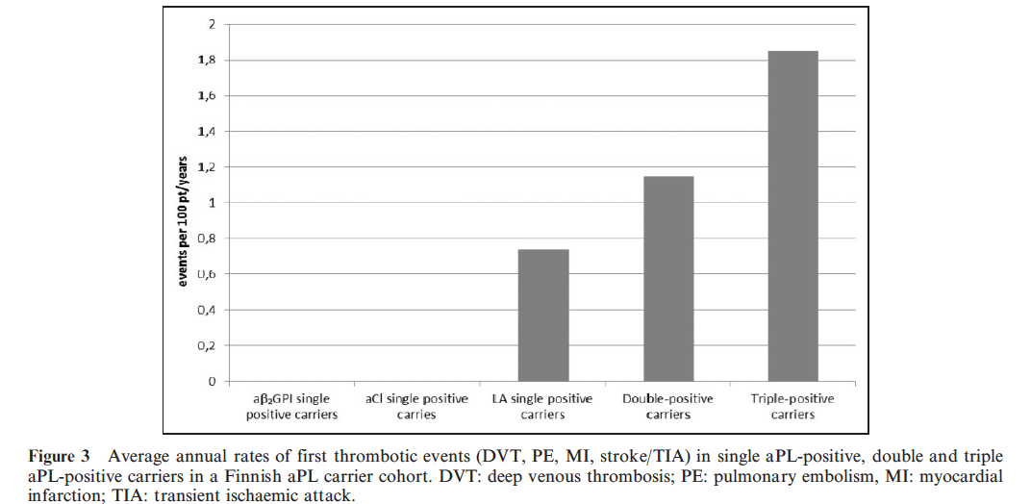
Obstetrical History As A Marker For Thrombotic Events
Recurrent unplanned abortions
Stillbirths
Premature birth with toxemia
Growth-restricted infant
Patients with any of these historical events may be carriers of one or more of the following abnormalities
Lupus Anitcoagulant (LA) positive, single anticardiolipin antibody positive (aCL), or anti-b2glycoprotein-I antibody positive (ab2GPI)
STRONG PREDICTOR OF A THROMBOTIC EVENT FOLLOWING SURGERY
Persistent antiphospholipid antibody (aPL) in asymptomatic carriers as a risk factor for future thrombotic events- a nationwide prospective study: Mustonen P et al. Lupus, 2014; 23(14):1468-76

Slide 18
Obstetrical History As A Marker For Thrombotic Events
Patients with a history of obstetrical complications who test positive for one or more components of the antiphospholipid antibody syndrome
Remain at increased VTE risk as long as these defects persist
These acquired thrombophilia markers may be transient or last for many years
Failure to identify those with this history having surgery later in life may result in a serious or fatal VTE events
A history of spontaneous abortion with negative testing still is associated with an increased VTE risk
Mustonen P. et al. Lupus, 2014; 23(14):1468-76
Quenby S. Human Reproduction Vol.20, No.6 pp. 1729–1732, 2005

Slide 19
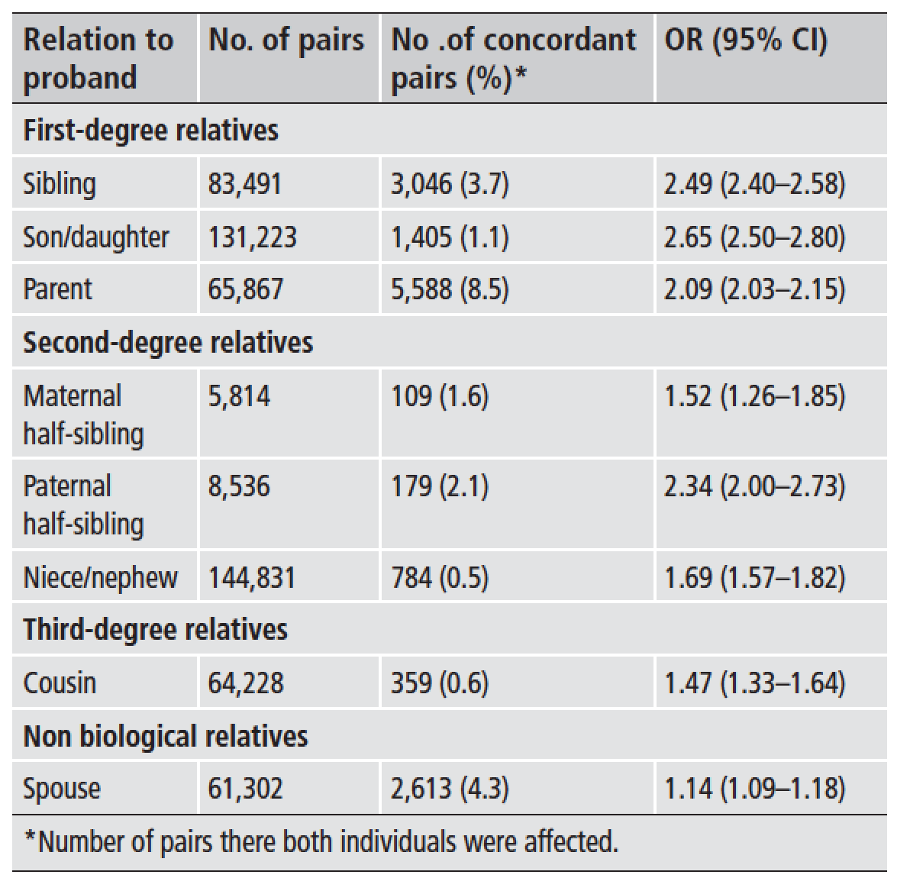
Familial Risk of Venous Thromboembolism in Relatives*
This study shows an increased VTE risk among not only first-degree relatives but also second- and third-degree relatives and non-biologic relatives
The genetic component of the familial clustering of VTE is strong
Family history is potentially useful for clinical VTE risk assessment, even in second- and third degree-relatives.
*(183,515 INDIVIDUALS)
Thromb Haemost 2013;109(3)458-63

Slide 20
Patient Friendly Risk Assessment Forms
English
Spanish
Arabic
Polish
Thai
Chinese
Turkish
Urdu South East Asia
Empower the patients and this process

Slide 21
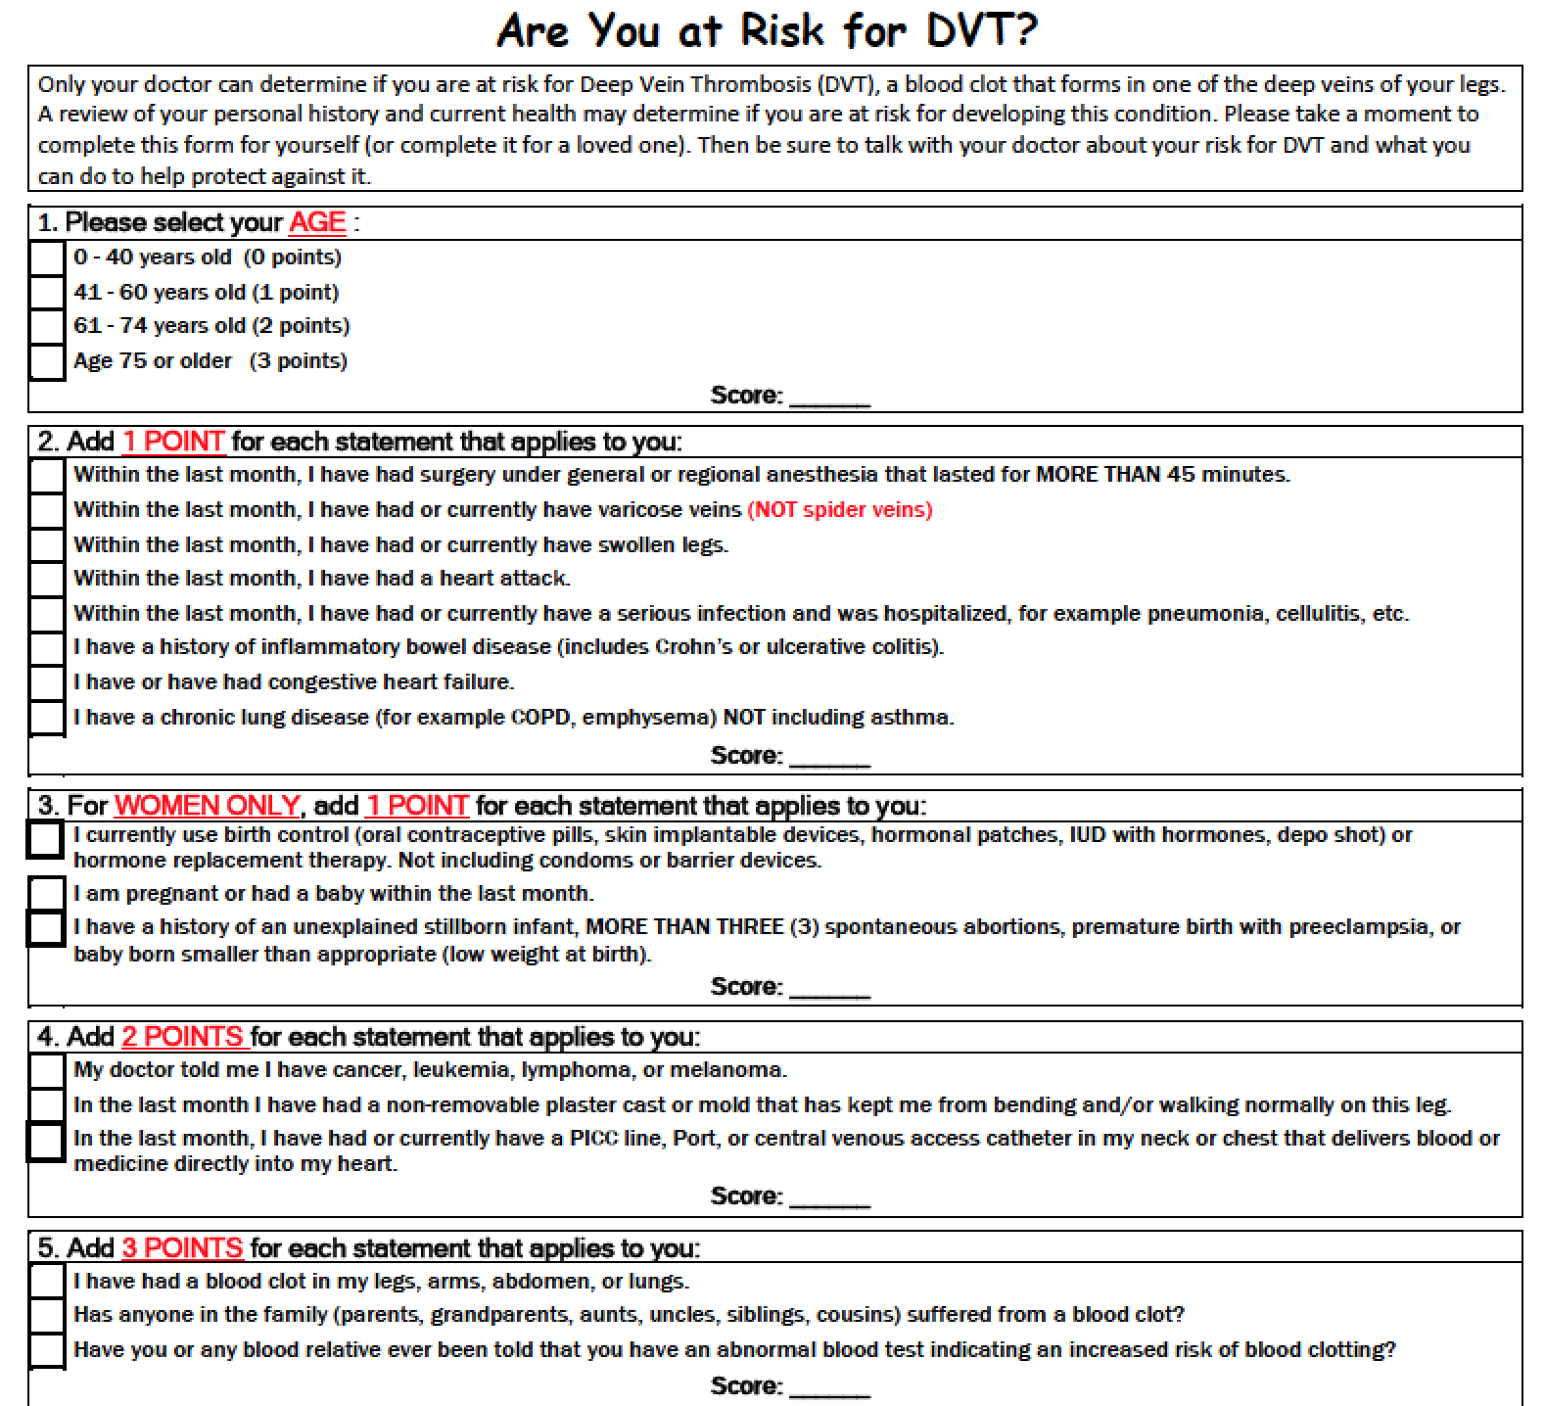
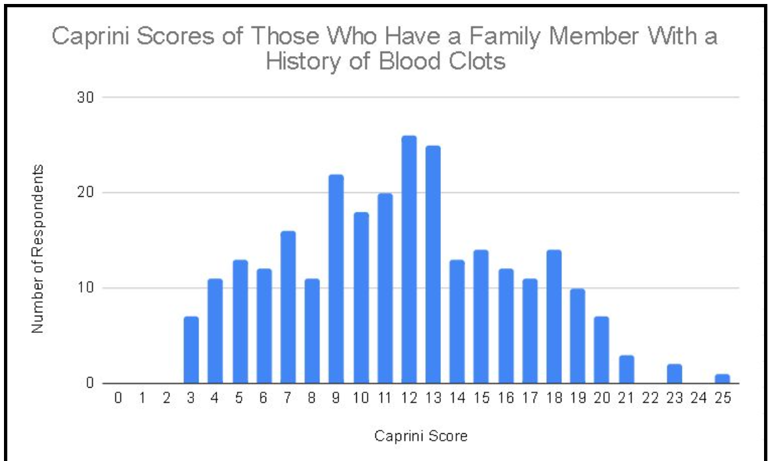
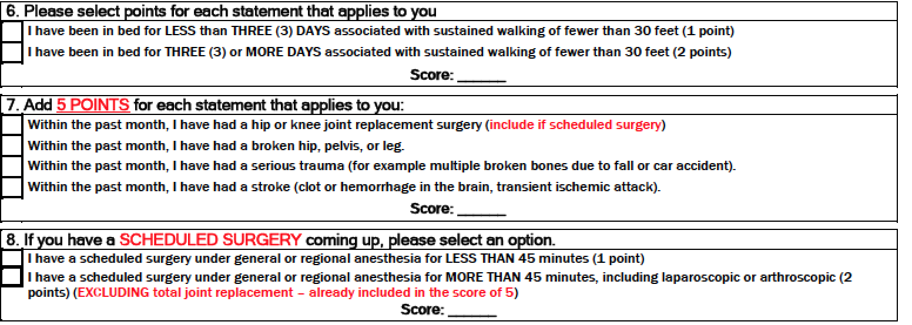
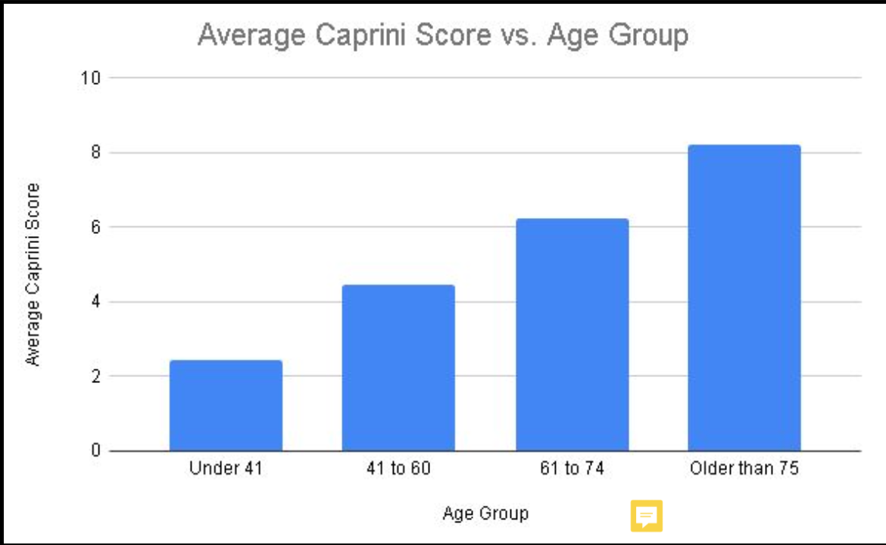
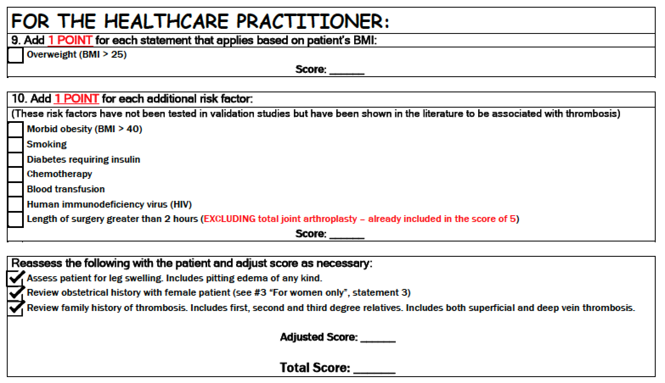
High School Students Completed This Form After Huddling With Their Family, And Entered Data Into A Secure Database
The Data Revealed A 26% Incidence Of Family History Of Thrombosis
Clinical Results Never Reveal More than 1-2% Of This Family History
Patients Older Than 75 Need Prophylaxis Even For Simple Procedures
Shetye, P., Gavankar, S, Saadaldin, H, et al,;AS-ISTH-2021-02054, 2021
Saadaldin, H., et al; Clin Appl Thromb Hemost, 2022. 28: p. 10760296221107020.
Huang, C., et al; Clin Appl Thromb Hemost, 2023. 29: p. 10760296231188425.

Slide 22
The Missing Link
Adobe stock

Slide 23
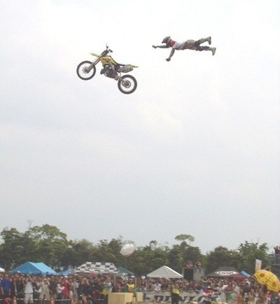
“There is a disconnect between evidence and execution as it relates to VTE prevention
Reducing VTE deaths requires mandatory implementation of appropriate care pathways

Slide 24
Mandatory Algorithm
LMWH 7-10 days Score 5-8
Compliance 89%
LMWH 30 days Score 9+
Compliance 77%
LMWH supplied regardless of the ability of the patient to pay
POSTER CHILD FOR THE USA!
I COUGH: August 2010
?

Slide 25
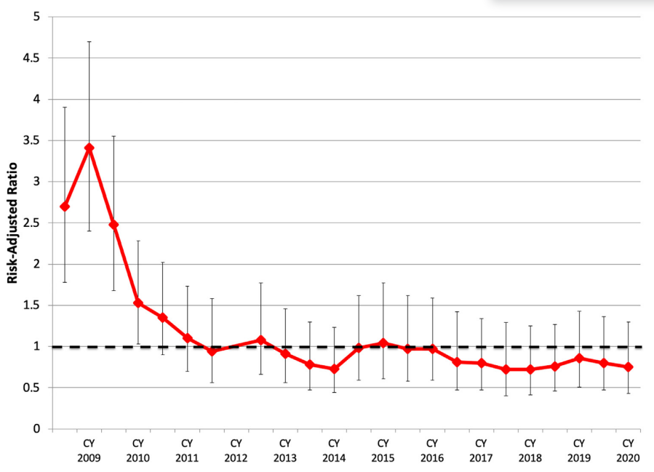
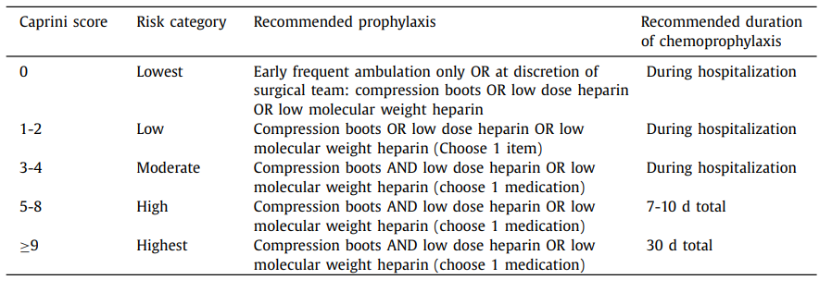
Mandatory Program Implementing Evidence-based Pathway At Boston University
Kobzeva-Herzog, A.J., et al., Sustained success of a Caprini postoperative venous thromboembolism prevention protocol over one decade. Am J Surg, 2024: p. 115783.

Slide 26
CONCLUDING THOUGHTS
THE risk assessment procedure must be followed in order to prevent venous thrombosis including fatal PE events
Family history of thrombosis and Obstetrical complications are KEY!
The score is a DYNAMIC instrument and MUST be updated during hospitalization and at discharge. (Regardless of the score used)
Extended prophylaxis following discharge important for patients with high-risk scores in any of the models
Mandated use of evidence-based algorithms employing nudge techniques to assure compliance are suggested
Peer review, financial incentives, practice audits, or leading by example
Depending Upon The Healthcare System, Country, Local Culture, And Ability To Collect Data, These Processes May Vary.

Slide 27
Performing a thorough history and physical gives you knowledge about your patient as if they were a good friend

Slide 28
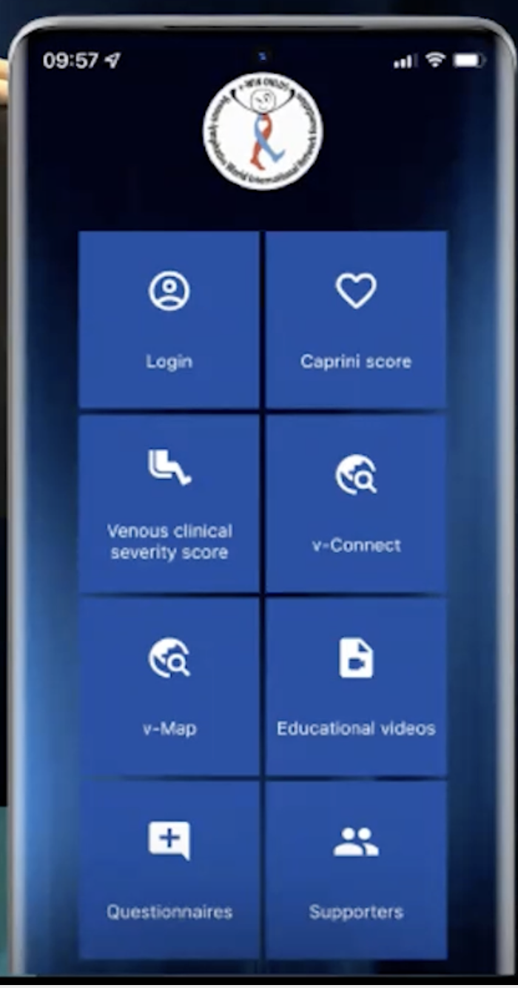
Risk Assessment Tools
www.capriniriskscore.org
YouTube: Caprini venous resource center
Facebook: Joe Caprini
X: @CapriniJoseph
Instagram: venous resource center
V-WIN APP

Slide 29
Thank You For Your Attention
Clinical Trials
Risk Assessment Tools
Courtesy Alfonso Tafur, MD
Website: www.capriniriskscore.org
YouTube: venous resource center
Facebook: Joe Caprini
X: @CapriniJoseph
Instagram: venous resource center

Slide 35
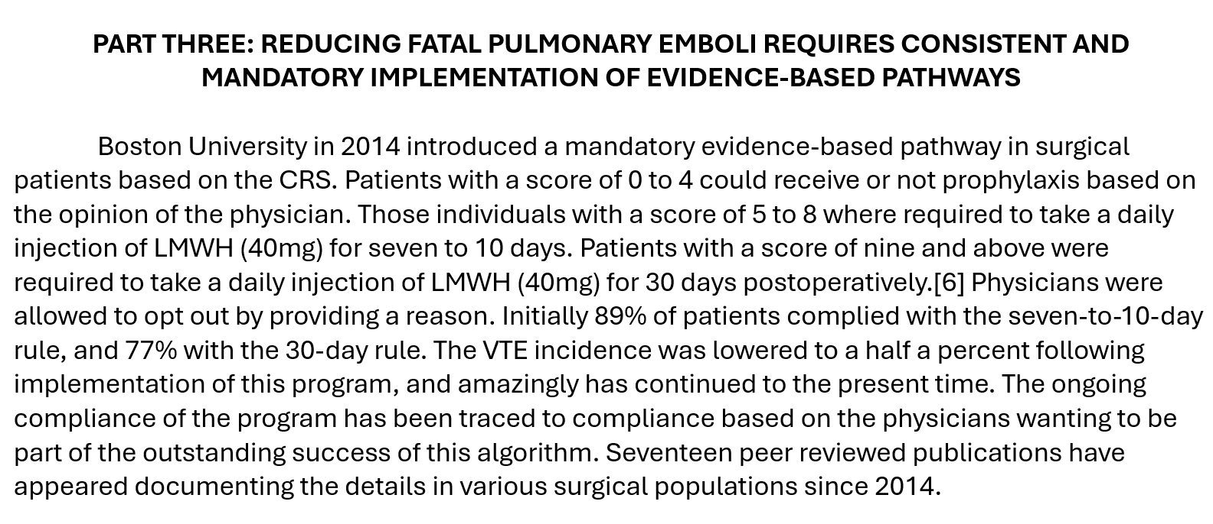

Slide 37
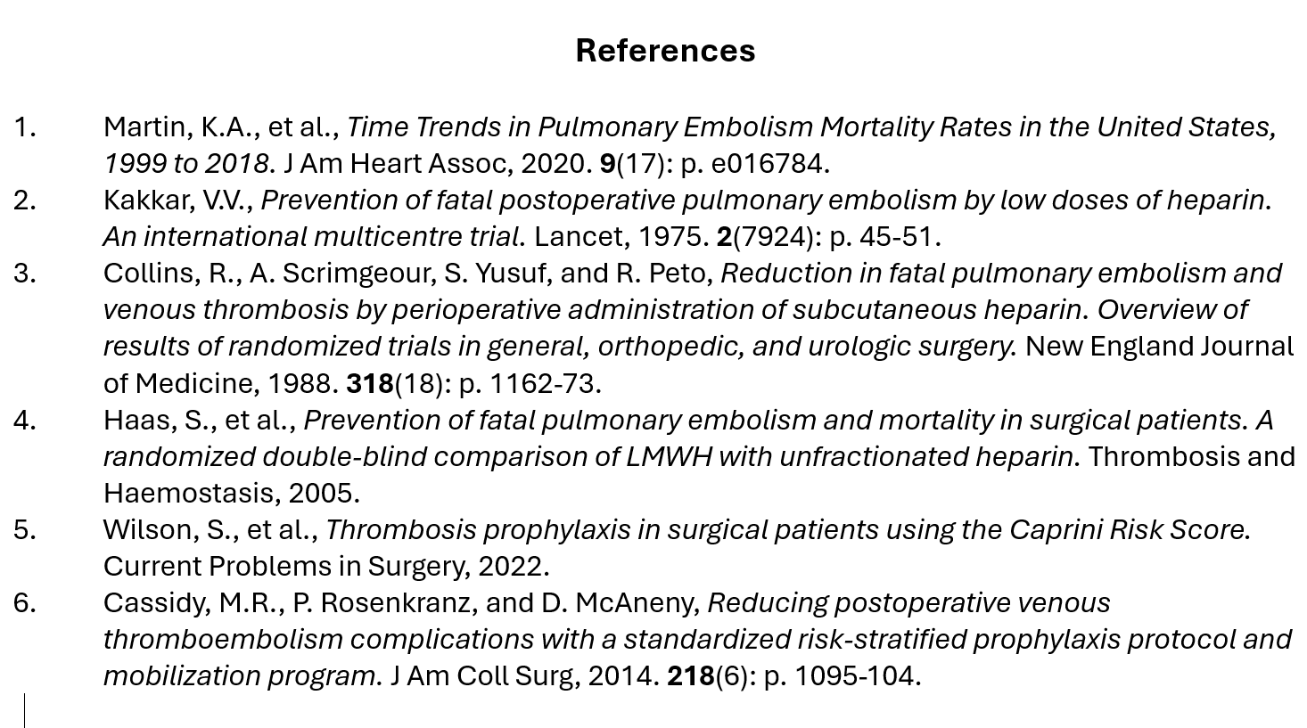

Slide 38
BCPEP Webpage Mockup Review

Slide 39
Workgroup Discussion

Slide 40
Public Comments

Slide 41
Meeting Summary

Slide 42
Next Steps

Slide 43
Adjournment

