Slide 1
Blood Clot and Pulmonary Embolism Policy (BCPEP)
May 29, 2024
This meeting is being recorded

Slide 2
Agenda

Slide 3
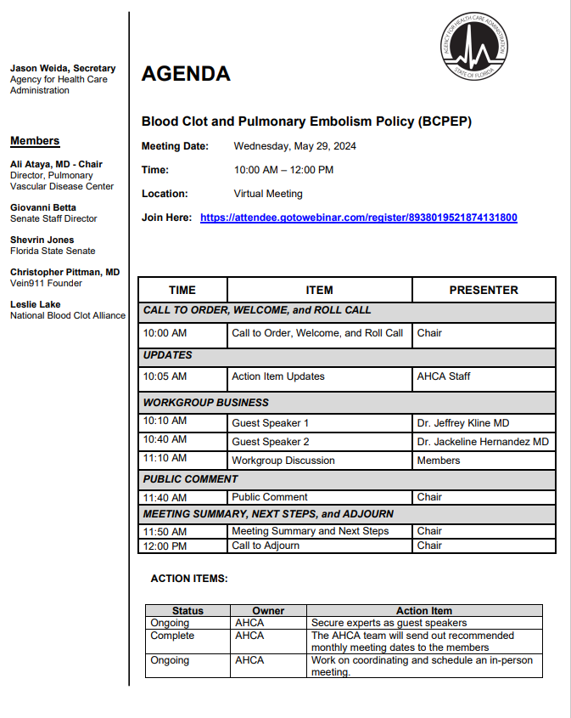

Slide 4
Call to Order, Welcome, and Roll Call

Slide 5
Agency Updates

Slide 6
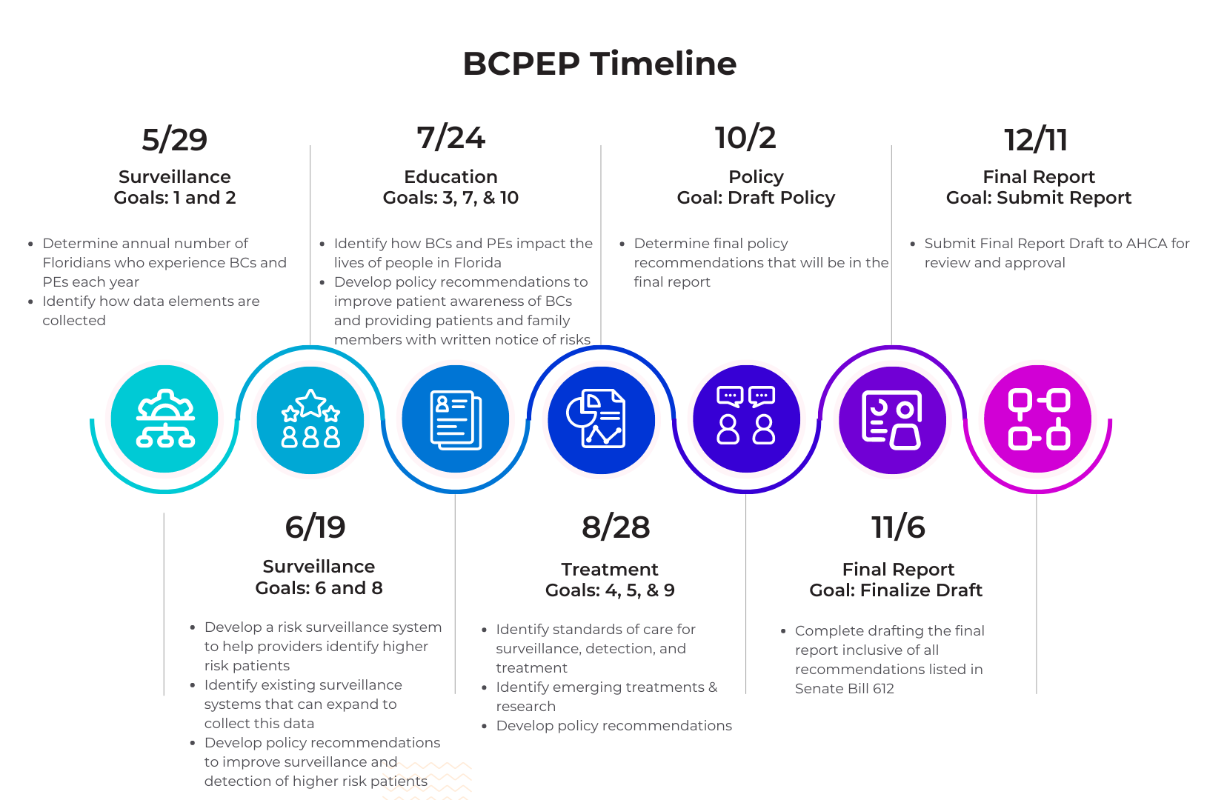

Slide 7
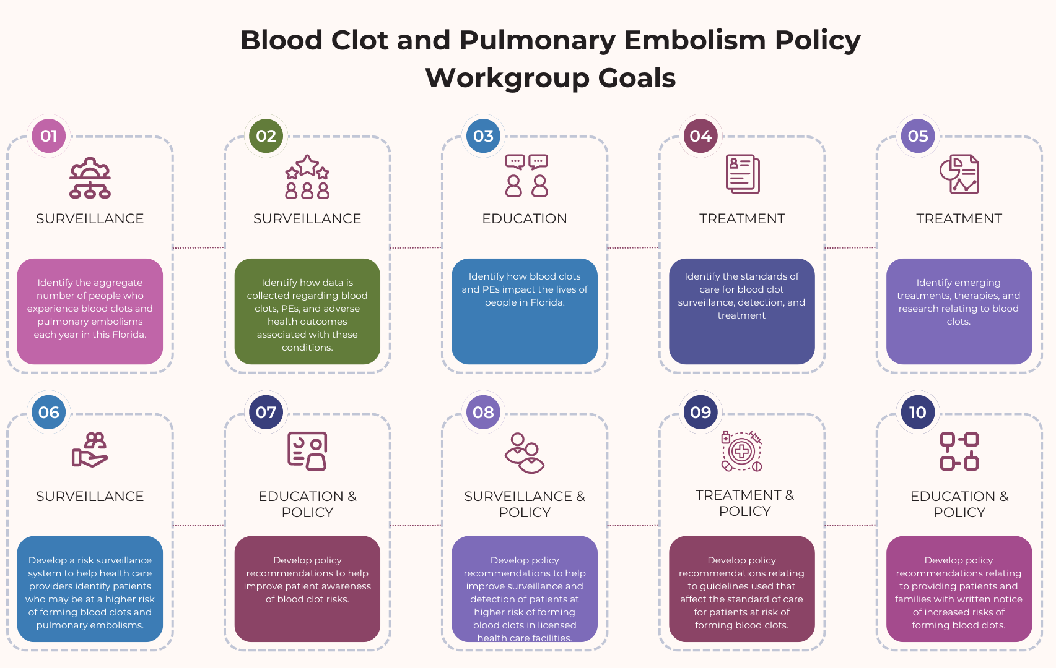

Slide 8
Review and Approve Previous Meeting Minutes

Slide 9
Previous Action Items and Status Updates

Slide 10
Pulmonary Embolism: Recent History and Current Issues
GUEST SPEAKER
Jeffrey A. Kline MD
Wayne State University

Slide 11
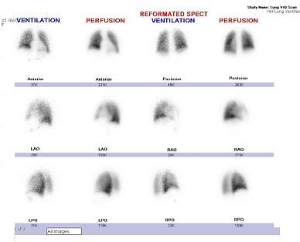
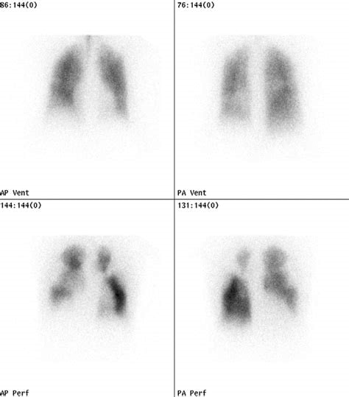
1990
Diagnosis made primarily with ventilation-perfusion lung scanning

Slide 12
1990
Incidence of PE approximately 1 in 1000 persons per year
Case mortality rate undiagnosed thought to be 30%
Treatment: unfractionated heparin then vitamin K antagonist (Warfarin)
30 day case mortality rate diagnosed and treated, approximately 10%
Second leading cause of sudden unexpected death

Slide 13
Dawn of Reperfusion
1992-FDA clears tPA for marketing for treatment of massive pulmonary embolism

Slide 14
History of Enzymatic Treatment
1967 Urokinase in humans with PE
(Art Sasahara N Engl J Med. 1967 Nov 30; 277(22):1168-73)
1968: 18 patients with SK and 3 with heparin
(Jack Hirsh, BMJ. 1968; 4: 729–734)
1970: UPET
(JAMA. 1970; 214: 2163–2172, Circ entire issue April 1973)
1980: tPA used in rabbits with PE
(Nature 1981; 291:590–1)

Slide 15
FDA clearance of tPA
1992-Sam Goldhaber single-handedly goes to FDA
-Dose based upon myocardial infarction
-Correct dose for PE remains unknown
-Heparin vagary remains

Slide 16
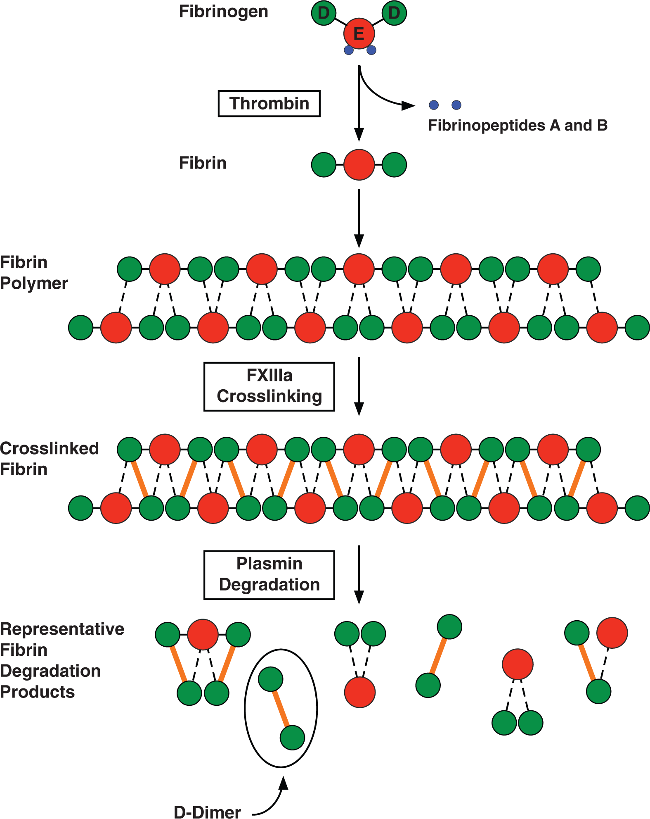
1995: D-dimer More Recognized

Slide 17
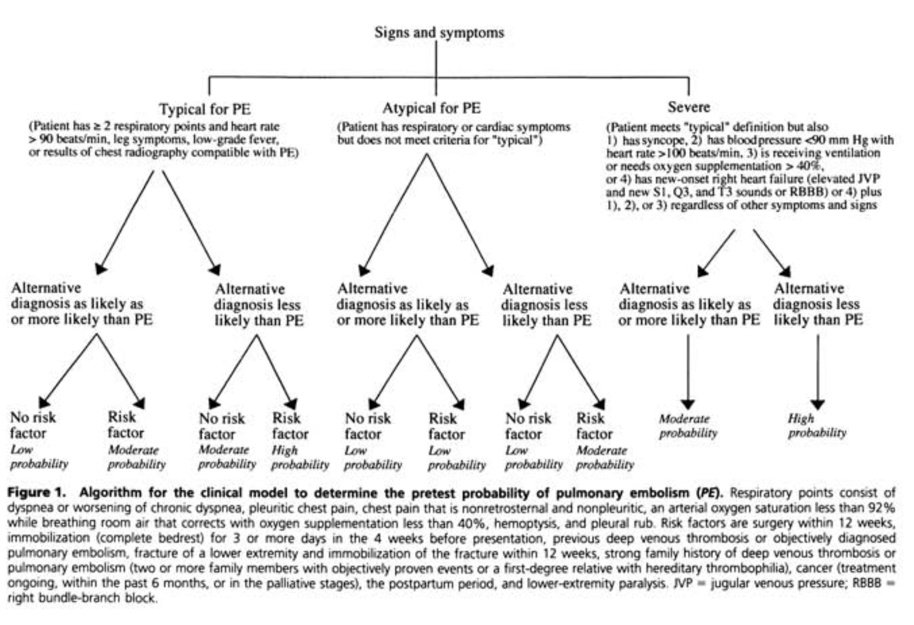
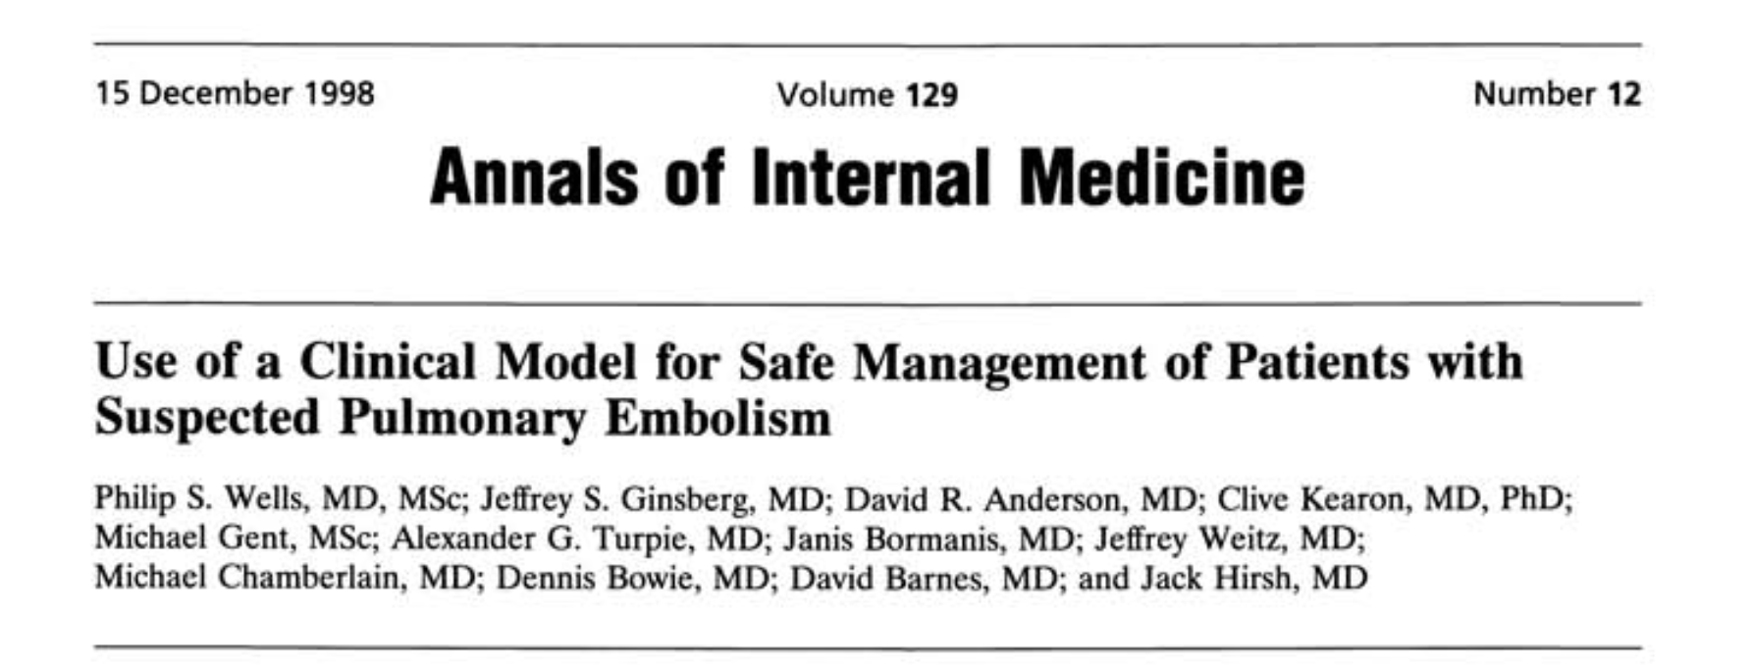
1998: Well’s Score

Slide 18
1995: D-dimer emerges as an exclusionary tool

Slide 19
D-dimer confusion post 2000
Biomeriux receives first clearance to market in 1999 (“Aid in exclusion”).
Approximately 35 D-dimer assays subsequently cleared by FDA Immunoturbidimetric versus ELISA
Multiple different thresholds for abnormal.
Helena 200 ng/mL
HemosIL 243 ng/mL (DDU)
Stago Diagnostica 500 ng/mL (FEU)
Nomenclature: FEU vs. DDU
Clin Chem 2015, 61:776-778. https://fda.gov/510(k) clearances (Accessed March, 2020)

Slide 20
1997: low molecular weight heparin
COLUMBUS

Slide 21
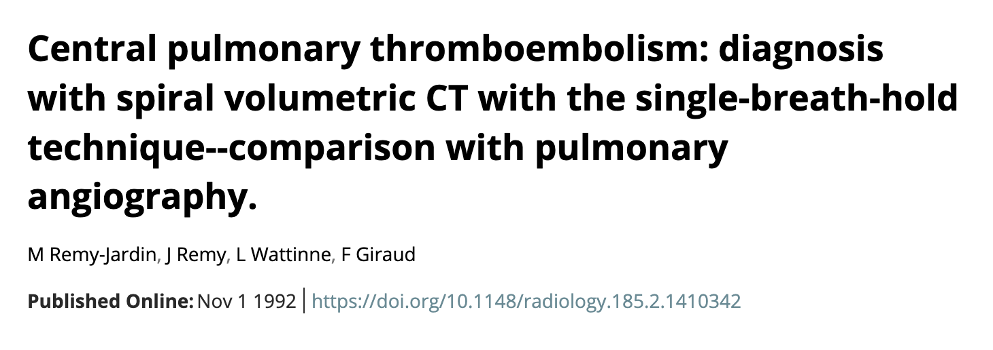
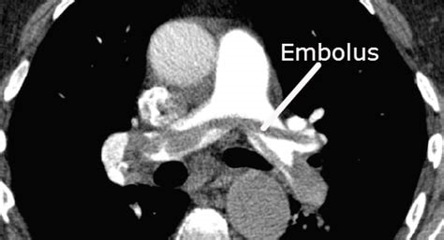
1999-2000-CTPE emerges

Slide 22
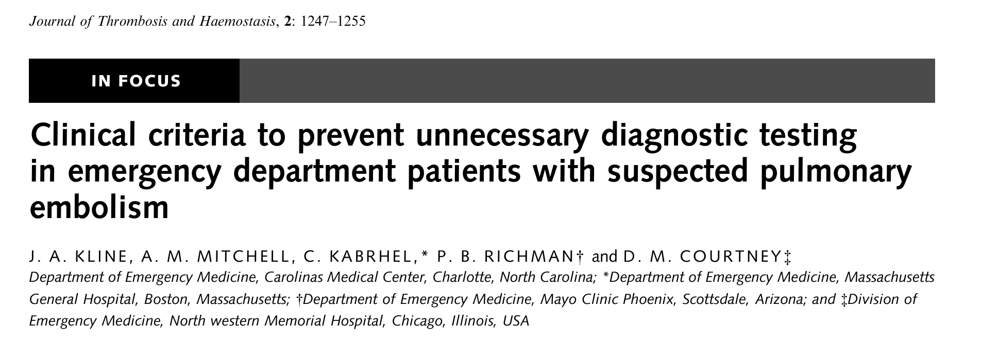
PERC Rule--2004

Slide 23
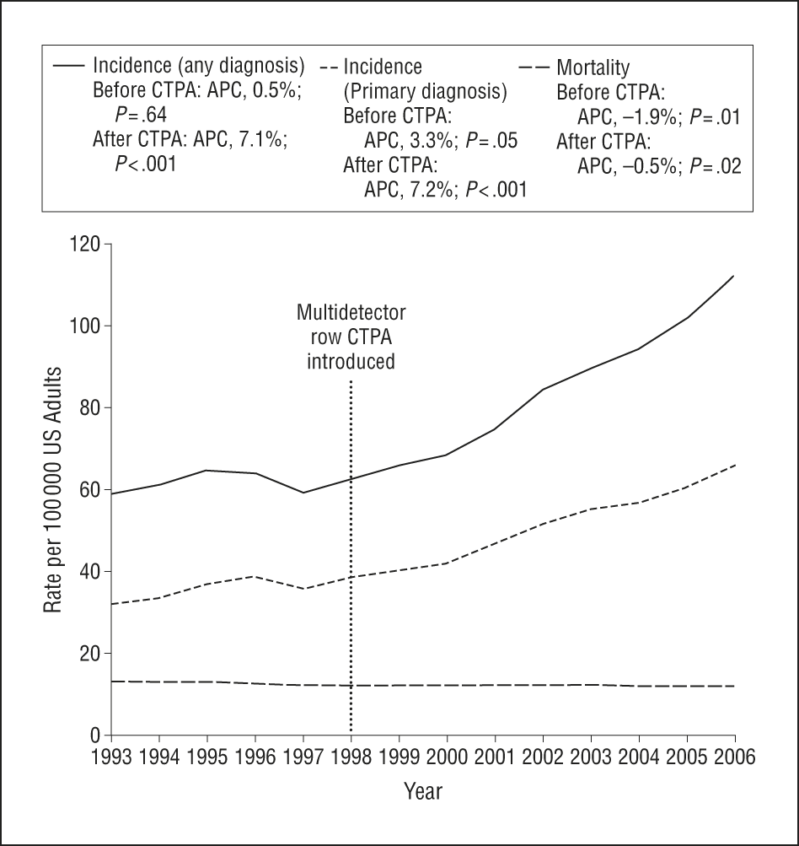
From: Time Trends in Pulmonary Embolism in the United States: Evidence of Overdiagnosis
Arch Intern Med. 2011;171(9):831-837. doi:10.1001/archinternmed.2011.178
Figure Legend:
Incidence and mortality of pulmonary embolism in the United States, 1993-2006. APC indicates annual percentage change; and CTPA, computed tomographic pulmonary angiography.

Slide 24
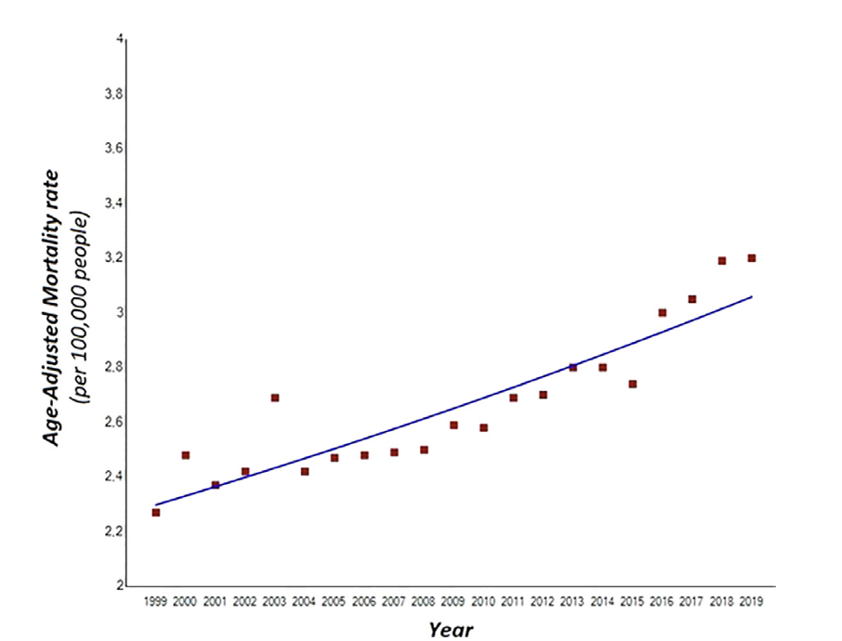
Am J Cardiol 2023;202:169−175

Slide 25
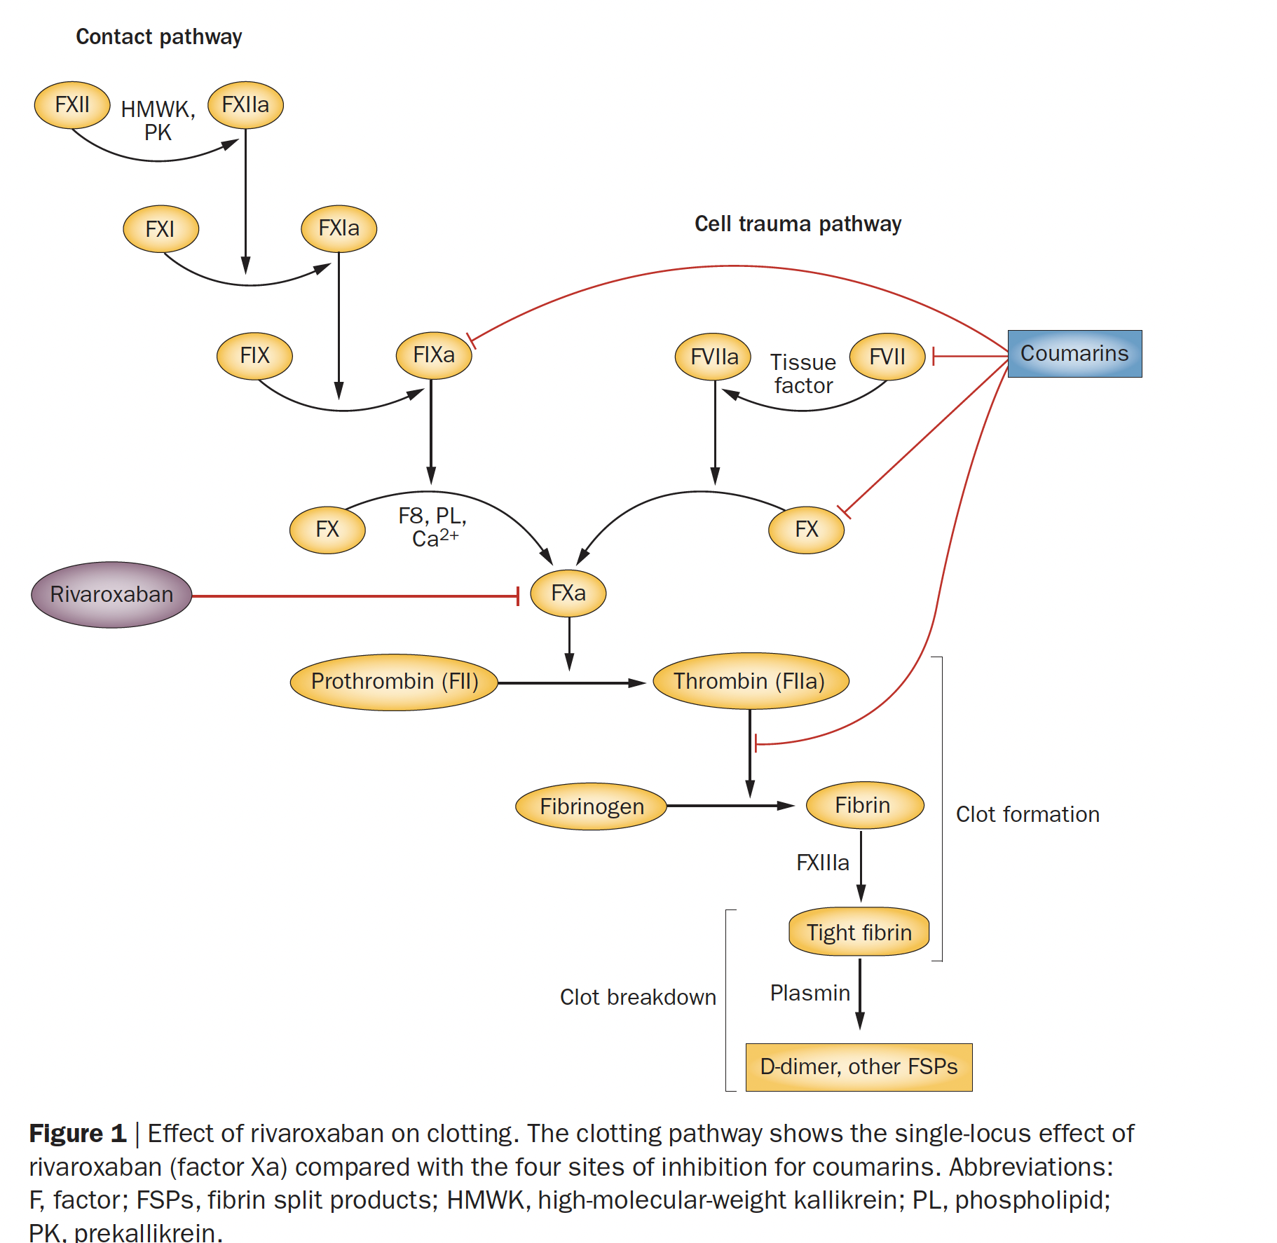
DOACS--2013
Rivaroxaban, then apixaban cleared by FDA
Directly inhibit factor 10
No need for heparin or dietary restrictions

Slide 26
2012-2024
Catheter-based treatment emerges
PERT teams (PERT consortium started by Chris Kabrhel, 2014
Now, clinical study of reperfusion therapy is dominated by industry

Slide 27
2024
PE still the #2 cause of sudden unexpected death
Several studies have suggested mortality increasing in the US, but not Europe

Slide 28
Why a surveillance network is needed
Currently, epidemiological data are inferred from databases not designed specifically to detect PE (e.g., NEDS, NIS, WONDER)
Disparities likely exist

Slide 30
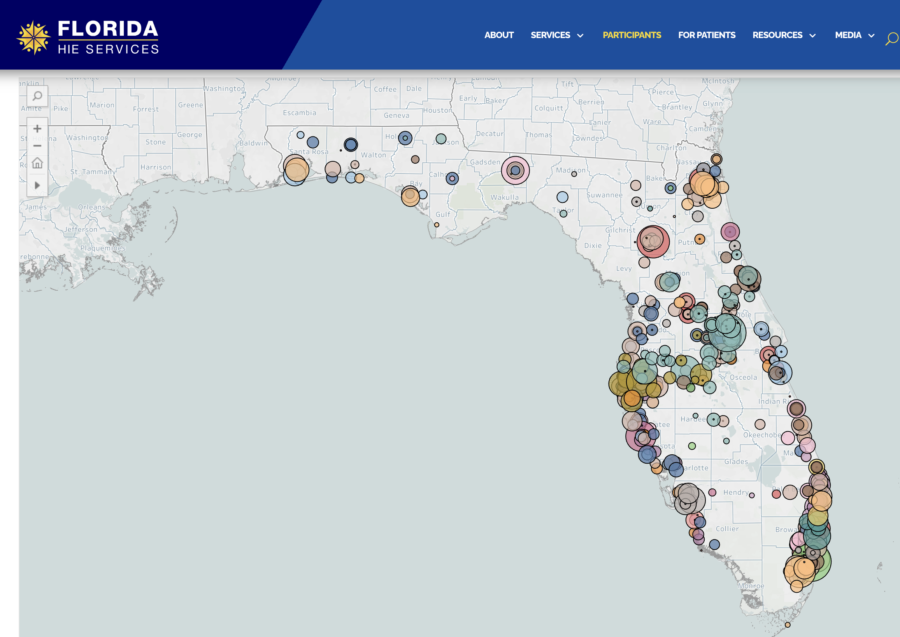

Slide 31
Key Questions To Consider
Scope:
Deep vein thrombosis and pulmonary embolism?
Diagnosed cases only, or include those imaged for PE (via CPT code)?
All Florida hospitals, or a sample of hospitals?
Patient level data or summary data?
New SQL coding at each site or modification of what exists on the HIE?

Slide 32
Methodological Questions
Methods of detection of DVT and PE:
ICD coding must be carefully considered
First ICD code versus contained within list
Coincident imaging and anticoagulation
Use of regular expression (RegEx) or natural language processing?

Slide 33
Methodological Questions
Methods of detection of DVT and PE:
ICD coding must be carefully considered
First ICD code versus contained within list
Coincident imaging and anticoagulation
What data to collect?
Frequency of collection
Budget to curate and modify the code on a regular basis

Slide 34
Questions?

Slide 35
Importance of Patient Communication
GUEST SPEAKER
Jackeline Hernandez MD
Atrium Health Carolinas Medical Center

Slide 36
Meeting Summary

Slide 37
Meeting Summary

Slide 38
Next Steps

Slide 39
Adjournment

