Slide 1
Blood Clot and Pulmonary Embolism Policy (BCPEP)
April 17, 2024
This meeting is being recorded

Slide 2
Agenda

Slide 3
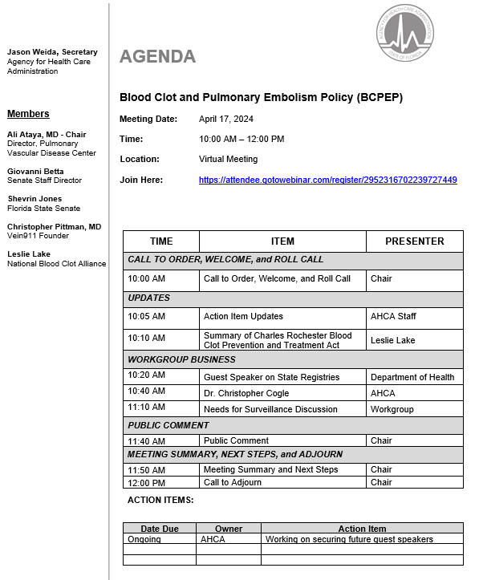

Slide 4
Call to Order, Welcome, and Roll Call

Slide 5
Action Items and Status Updates

Slide 6
Summary of Charles Rochester Blood Clot Prevention and Treatment Act

Slide 7
State Registries Guest Speaker:
Melissa Jordan, Assistant Deputy Secretary of Health, FDOH

Slide 8
Guest Speaker:
Christopher R. Cogle, M.D.,
CMO for Florida Medicaid

Slide 9
BCPEP Workgroup Discussion:
Needs for Surveillance

Slide 10
VTE Statistics
VTE is estimated to affect over 900,000 people annually in the United States, accounting for over 100,000 deaths. (1)
Estimated average annual incidence is ~108 per 100,000 (2)
True incidence and prevalence is likely much higher since up to 30% of cases may be asymptomatic or go undiagnosed.
Direct medical costs for treatment of VTE ~5.8-7.8 billion dollars (1)
Around 60% of VTE cases are associated with recent hospitalization or nursing home admission (3,4)
1. Arterioscler Thromb Vasc Bio. 2008; 28: 370
2. Arch Intern Med. 1991; 151: 933
3. Mayo Clin Proc. 2001; 76: 1102-1110
4. Arch Intern Med. 2002; 162: 1245-1248

Slide 11
Need For Surveillance
There is a need for systemic collection of VTE incidence and VTE-related morbidity and mortality.
  Develop case definition
  Identify indicators and data sources
  Partners to undertake surveillance
  Collecting, analyzing, and disseminating data and findings
  Evaluate the system and its impact on VTE

Slide 12
VTE Surveillance
Establishing a Florida database is essential to gather annual incidence/prevalence of DVT and PE and associated mortality. This can also help estimate the healthcare burden and cost of VTE.
  Need geographic representation of annual rates
  Need demographic breakdown
  Define groups that are at different risk
  Be able to detect change over time

Slide 13
Recommendation: Step 1
Can DOH obtain age-adjusted annual rates of DVT, PE, and combined (VTE) throughout Florida? Other data to request:
Annual rates of ER visits, hospitalizations, mortality
Breakdown data to four age groups (0-12, 13-39, 40-64, 65+)
Breakdown by location/county (heat map of Florida), sex, demographics, race/ethnicity
Incidence of VTE from all hospital discharges
Data on incidence from hospitals, long-term health facilities, free-standing ambulatory surgical centers, emergency departments
Determine cost of hospitalizations, rate of chronic complications (can provide ICD-10 codes)

Slide 14
Recommendation: Step 2
Data collection as Quality measures – website reporting of VTE by hospital systems

Slide 15
Recommendation: Steps 3
Establish a Florida VTE registry

Slide 16
Reporting Discussion
1. The annual reporting of statewide incidence of DVT and PE by the Department of Health.
2. The establishment of a statewide DVT and PE registry program to ensure all VTE reports are maintained. Registry should also be available for patient care use or research study for the purpose of reducing morbidity and mortality.
No liability of any kind or character for damages or other relief shall arise or be enforced against any facility or practitioner by reason of having provided such information or material to the Department of Health. [identical to Section 385.202 Florida Statute]

Slide 17
Registry Ideas
Every facility to report to DOH (Should we request the creation of a Data system similar to the Florida Cancer Data System (FCDS))
Type of data to collect
Frequency of reporting of registry. For much larger centers more frequently than smaller centers, but all within certain time frame (3 months of diagnosis)

Slide 18
Registry Ideas Continued
Death certificate cases – mortality follow-back – to identify VTE-related deaths
Hospital discharge data showing a diagnosis of VTE (primary or secondary diagnosis) – usually reported to AHCA
The establishment and support of VTE or PERT centers and PE/DVT clinics can also aid in capturing and reporting cases
Reporting of chronic complications of VTE

Slide 19
Additional Recommendation
Support the formation and designation of VTE clinical expert centers in Florida
This would entail the presence of multidisciplinary care to DVT/PE
The presence of PERT at the centers
Post-PE follow-up
Chronic VTE management (chronic DVT, CTED, CTEPH management)
Help improve reporting data to registry

Slide 20
Public Comments

Slide 21
Meeting Summary

Slide 22
Next Steps

Slide 23
Adjournment

