Slide 1
Blood Clot and Pulmonary Embolism Policy (BCPEP)
February 21, 2024
(This meeting is being recorded)

Slide 2
Agenda

Slide 3
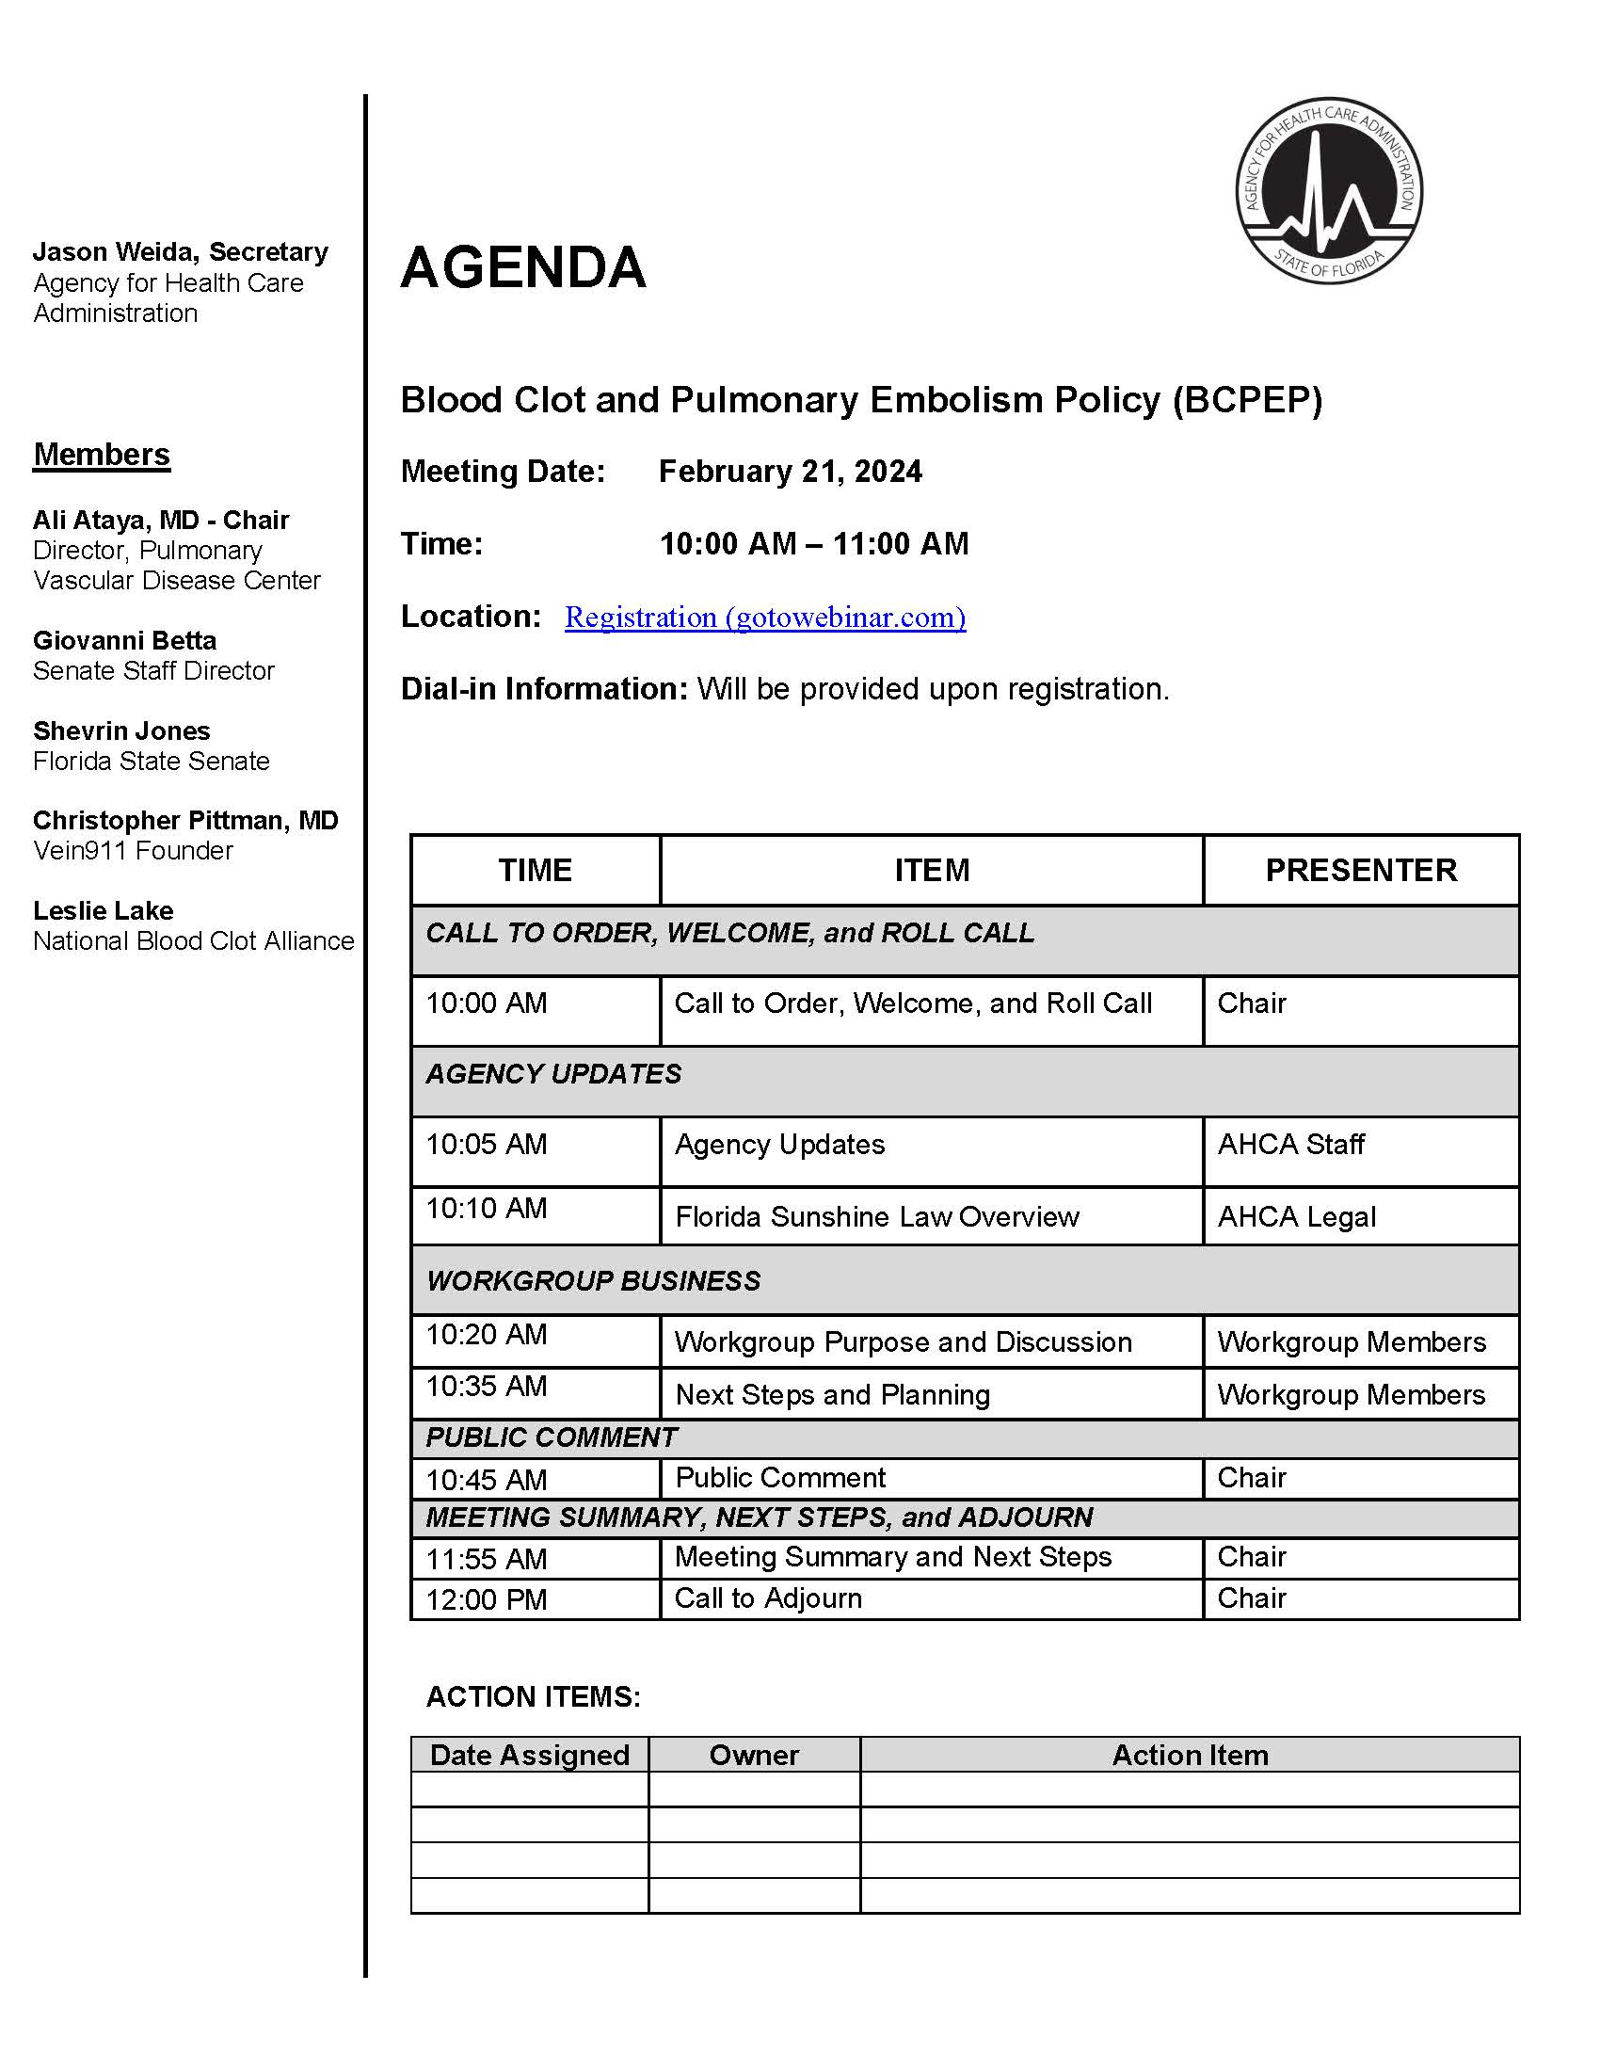

Slide 4
Call to Order, Welcome and Roll Call

Slide 5
Agency Updates

Slide 6
Florida Sunshine Law Overview

Slide 7
An Overview Of The Sunshine Law

Slide 8
The History of Florida’s Sunshine Law
In 1967, the Florida Legislature passed the Government-in-the-Sunshine law, which became the nation’s first open meetings law. It was codified at Chapter 286, Florida Statutes.
In 1992, Florida voters approved a proposed constitutional amendment guaranteeing Florida citizens a right of access to public records and meetings. It became Article I, Section 24 of the Florida state constitution.

Slide 9
Who Does the Sunshine Law Apply To?
The Sunshine Law governs the actions of members of a collegial body.
A collegial body would include commissions, advisory boards, ad hoc committees, or task forces.
AHCA is not a collegial body, so meetings of its employees are not subject to the Sunshine Law UNLESS the employees are meeting as an appointed committees.
Additionally, collegial bodies formed solely for the purpose of fact-finding are not subject to the Sunshine Law.

Slide 10
What Are the Requirements of the Sunshine Law?
There are 3 basic requirements under the Sunshine Law:
A collegial body’s meetings must be open to the public;
A collegial body must give the public reasonable notice of its meetings; and
A collegial body must keep minutes of its meetings.

Slide 11
What Constitutes a Meeting Under the Sunshine Law?
A “meeting” of a body subject to the Sunshine Law is broadly defined to include any gathering – formal or informal – during which two or more members of the body discuss the official business of the body. Accordingly, business-related discussions between members of the collegial body may only take place at open, properly-noticed meetings. Members may not discuss the business of the collegial body with each other through private phone conversations or e-mail discussions.
Members may distribute documents to each other, but they may not discuss or exchange comments on those documents outside of a public meeting.
Members may also discuss business with third parties (i.e., non-members of the body), provided the members do not use a third party as a liaison for business-related communication with other members.

Slide 12
Giving Notice of Public Meetings
The requirements for notice of public meetings are found in section 120.525, Florida Statutes. These requirements are more specific than those of the Sunshine Law and dictate the following:
Notice of public meetings, hearings, and workshops shall be by publication in the Florida Administrative Register not less than 7 days before the event. The notice shall include a statement of the general subject matter to be considered.
An agenda shall be prepared in time to ensure that a copy of the agenda may be received at least 7 days before the event by any person in the state who requests a copy and who pays the reasonable cost of the copy. The agenda shall contain the items to be considered in order of presentation. After the agenda has been made available, a change shall be made only for good cause, as determined by the person designated to preside, and stated in the record. Notification of such change shall be at the earliest practicable time.

Slide 13
Public Participation
Members of the public must be given a “reasonable opportunity to be heard” on a proposition before a state board or commission. The board may adopt policies governing this opportunity. This requirement may be enforced by injunction, and a court may award attorneys fees to the complainant.

Slide 14
Minutes of Meetings
Although the Sunshine Law requires the collegial body to record minutes of its meetings, such minutes need not be verbatim transcripts of the proceedings. A summary or notes of the meeting is sufficient. It is within the collegial body’s discretion to determine who is responsible for creating the minutes of meetings.

Slide 15
Sunshine Law and Public Records
As a general matter, any documents or other materials that are (1) created or received by collegial body members, (2) related to the collegial body’s official business are “public records” which must be made available to the public for inspection and copying.
Examples of public records made or received by collegial body members relating to their official business include reports, correspondence (including email and texts), and personal notes.
Any confidential information made or received by a collegial body would retain its statutory exemption from disclosure as a public record. Collegial body members should also take care during the public meetings not to discuss information derived from such confidential records.

Slide 16
QUESTIONS?

Slide 17
Workgroup Purpose and Discussion

Slide 18
Overview on Venous Thromboembolic (VTE) Disease
February 21, 2024

Slide 19
Overview
When blood clots develop in the legs, they are termed deep vein thrombosis (DVT)
Symptoms: leg swelling, pain, redness, tenderness to touch
When a blood clot from a DVT breaks off and travels to the lungs, this results in pulmonary embolism (PE)
Symptoms: shortness of breath, chest pain, high heart rate, low oxygen, cardiac arrest
The spectrum of DVT and PE together are known as venous thromboembolism (VTE). These require immediate recognition and treatment

Slide 20
Extent of the problem
900,000 people affected by VTE annually in the US
60,000 – 1,000,000 people die each year from VTE
VTE may account for 25% of sudden deaths
Accounts for 1 in 10 in-hospital deaths
Leading case of maternal death during and after pregnancy
33% of affected individuals have long-term complications and will have a recurrence within 10 years
www.cdc.gov/ncbddd/dvt/

Slide 21
Risk Factors for VTE Include:
Advancing Age | History of VTE
Surgery or Trauma Within Last 4 Months | Hospitalization or Nursing Home Stay
Active Cancer | Spinal Cord Injury or Paralysis of the Leg
Obesity | Venous Catheters or devices
Chronic Medical Conditions | Pregnancy and Postpartum Period
Hormonal Therapy Use (i.e. estrogen contraceptives) | Inherited Thrombophilia Disorder

Slide 22
Assessing patients risk for developing VTE
Identify those who may be at risk of blood clots and their need for anticoagulation prophylaxis
Risk assessment of admitted patients can be calculated by different scoring systems:
Padua Predication Score (PPS) or Geneva Risk Score for VTE for medical patients
Caprini Risk Assessment Model (CRAM) for surgical patients
Notes:
Compliance with VTE prophylaxis of at-risk medical conditions in hospitals is low due to:
Need for assessment of VTE risk and to implement measures that patients receive their prophylaxis (education, an opt-out system, etc.)

Slide 23
Treatment Algorithm of patients with VTE
Early identification and treatment is crucial
Ultrasound is used to evaluate DVTs in extremities
Computed Tomography (CT) pulmonary angiography of the lungs is used to detect Pes
Based on clinical stability and other parameters, patient are risk stratified to determine best course of treatment
Some centers have developed PE response teams (PERT) that are activated to rapidly treat these patients

Slide 24
Follow-Up of VTE
Important for adequate follow-up of VTE patients:
Evaluate cost and access to therapy
Evaluate bleeding side effects and drug-drug interactions
Determine duration of treatment
Evaluate for chronic complications of VTE:
Post-thrombotic syndrome from DVTs
Chronic shortness of breath
Chronic thromboembolic pulmonary hypertension (CTEPH)

Slide 25
Structured Surveillance System
Currently there is no structured VTE surveillance in the US
Developing a surveillance system includes specifying objectives:
Describe the burden of disease
Identify risk factors
Evaluate impact on the population of prevention and treatment strategies
Detect changes in healthcare practice and impact on the burden of disease
Identify research needs
www.cdc.gov/

Slide 26
Important Steps for Surveillance
Developing a case definition
Identifying indicators and data sources (FloridaOne, FL DOH, AHCA)
Field testing, Collecting and analyzing data
Disseminating data findings
Evaluating the system and its impact on the health problem
Am J Prev Med. 2010 Apr;38(4 Suppl):S502-9

Slide 27
Areas of Need
Structured surveillance system and reporting of DVT/PE
Identify and support/build expert treatment centers for VTE that have PERT teams and specific Pulmonary Vascular Programs
Increase healthcare system compliance with identifying those at risk and VTE prophylaxis
Increase population education on VTE for self-advocacy
Better access to care and medications for those with acute VTE and chronic PEs
Support to increase CTEPH treatment centers care in Florida
Identify research opportunities in the space

Slide 28
Next Steps and Planning

Slide 29
Public Comments

Slide 30
Meeting Summary and Next Steps

Slide 31
Call to Adjourn

