Slide 1
Medical Care Advisory Committee Meeting
January 31, 2024

Slide 2
MCAC - Meeting Agenda
Opening Remarks
Quality Strategy Review
1115 Waiver
Public Comments
Adjourn

Slide 3
Opening Remarks
Kristin Sokoloski, Deputy Chief of Staff,
Medicaid Operations and Contracts

Slide 4
BLACKOUT PERIOD
“As we have entered the statutory blackout period as described in s. 287.057(25), F.S., due to the upcoming competitive procurements relating to the Statewide Medicaid Managed Care Program, we will not have any discussions relating to the scope, evaluation, or negotiation of those procurements.”

Slide 5
Meeting Logistics
MCAC Members can un-mute themselves and are welcome to comment or ask questions throughout the meeting.
All other Teams attendees will remain muted for the duration of the meeting to minimize disruption.
Attendees who wish to comment or ask questions should use the “Raise your hand” feature. We will recognize you to speak during the specified public comment period.

Slide 6
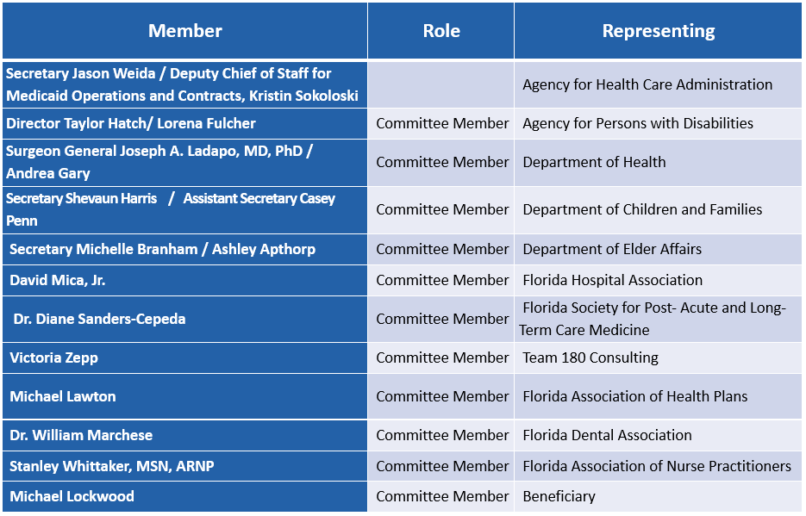
Roll Call

Slide 7
Quality Strategy Review Ken Kniepmann

Slide 8
Comprehensive Quality Strategy
Each state Medicaid program must update and submit a Comprehensive Quality Strategy (CQS) every three years.
It is a summary of the various tools used throughout the Medicaid program to drive higher quality outcomes for Medicaid recipients.
The CQS documents goals, initiatives, and activities that guide the delivery of Medicaid services in Florida.
The report details the methods and metrics for assessing plan performance; monitoring activities; and the evaluation design of the CQS and SMMC program.

Slide 9
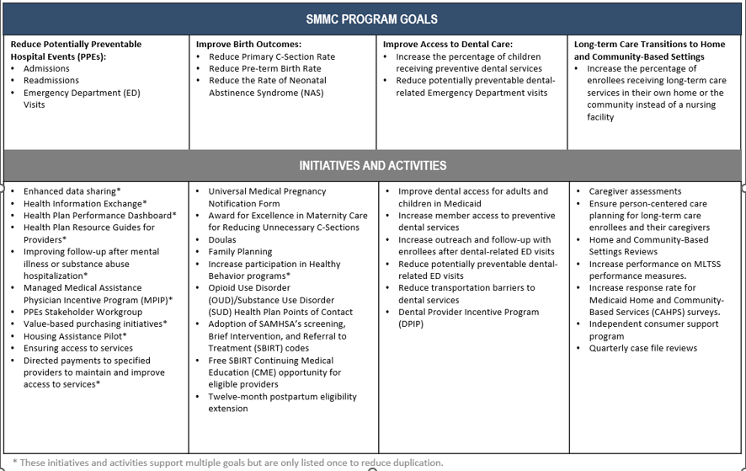

Slide 10
CQS Structure
Section I provides an introduction.
Section II contains a brief overview of the Statewide Medicaid Managed Care (SMMC) program, including the four primary goals:
Section III describes program goals, initiatives and activities that support those specific goals, as well as additional initiatives and activities that support multiple goals and health care improvement more broadly.
Section IV describes the use of performance measures to assess program performance for health and dental plans.
Section V details the Agency’s monitoring of the operational performance of the health and dental plans, as well as the way in which the Agency uses quality improvement contracts to monitor and improve Medicaid covered services.
Section VI describes the Agency’s evaluation of the SMMC program and the CQS.
Section VII briefly addresses the future of the SMMC program, which will be driven by the results of the new SMMC procurement.

Slide 11
Next Steps
The CQS will be publicly posted for a 30-day public comment period.
MCAC members are asked to review CQS and submit any comments in writing.
Instructions for submitting comments will be included in the posting.

Slide 12
Florida Medicaid
1115 Children’s Health Insurance Program
Eligibility Extension Request
January 31, 2024 & February 1, 2024
Public Meeting

Slide 13
Overview
This is a request for a new 5-year 1115 research and demonstration project to start approximately on or after April 1, 2024.
The demonstration seeks to:
Increase eligibility for Children’s Health Insurance Program (CHIP) subsidized KidCare programs from the current threshold of 200% of the federal poverty level (FPL) (210% post-MAGI) up to 300% of the FPL.
Establish new, graduated monthly premiums for CHIP enrollees to allow families with growing income to be able to continue to afford health insurance.

Slide 14
1115 Research and Demonstration Projects
Section 1115 of the Social Security Act gives the Secretary of Health and Human Services authority to approve experimental, pilot, or demonstration projects.
These demonstration projects give states additional flexibility to design and improve their programs.
States can demonstrate and evaluate policy approaches such as:
Expanding eligibility to individuals who are not otherwise Florida Medicaid or CHIP eligible.
Providing services not typically covered by Florida Medicaid.
Using innovative service delivery systems that improve care, increase efficiency, and reduce costs.
Demonstrations must also be “budget neutral” to the federal government, which means that during the course of the project, federal Medicaid expenditures will not be more than expected federal spending without the demonstration project.

Slide 15
Public Notice and Comment Period
Prior to submitting an application to the Center for Medicare and Medicaid Services (CMS) for a new demonstration project, the State must provide at least a 30-day public notice and comment period.
Florida is required to publish a public notice document that includes a comprehensive description of the program for at least 30 days prior to submitting the waiver request.
The public notice document is available at the following link for review and comment from January 23, 2024, through February 21, 2024, at 3:00 p.m. EST:
Request for Approval of 1115 Children’s Health Insurance Program Eligibility Extension (myflorida.com)
Written comments with the subject “CHIP Eligibility Extension Request” can be emailed to FLMedicaidWaivers@ahca.myflorida.com or mailed to:
Agency for Health Care Administration
2727 Mahan Drive, MS#20
Tallahassee, FL 23208

Slide 16
CHIP Eligibility Extension Public Meetings
January 31, 2024/ 11:00 am – 12:00 pm EST
Medical Care Advisory Committee
2727 Mahan Drive, Building 3
Tallahassee, FL 32308
February 1, 2024/ 1:00 pm - 2:00 pm EST
DMS Orlando North Tower Conference Room
400 W. Robinson St, Ste. N109
Orlando, FL 32801

Slide 17
Current Program
Currently, children with family income up to 200% of the FPL (210% post-MAGI) can enroll in CHIP with a subsidized premium.
Families contribute monthly premiums.
Premiums do not vary by family size.
State subsidized premiums vary from $15 to $20 per month and cover all children in the family.
Children with family income above 200% of the FPL (210% post-MAGI) can enroll in CHIP but the family must pay the full cost of the insurance for each child.

Slide 18
Proposed Demonstration Project Details

Slide 19
Eligibility
In the proposed demonstration, children with family incomes exceeding 200% of the FPL (210% Post-MAGI) up to 300% of the FPL would be eligible for CHIP.
This is a household income range for a family of four of $62,400 to $93,600.

Slide 20
Monthly Premiums
There are six proposed income-based premium tiers.
Premiums range from $17 to $195 per month and will continue to cover all children in the family.
Families with growing incomes can continue to afford CHIP health insurance with graduated monthly premiums.

Slide 21
Premium Tiers
 | Tier 1 | Tier 2 | Tier 3 | Tier 4 | Tier 5 | Tier 6
FPL Range | 133 – 175% | 175 – 200% | 200 – 225% | 225 – 250% | 250 – 275% | 275 – 300%
Current Premium | $15 | $20 | Full Pay | Full Pay | Full Pay | Full Pay
Proposed FPL* | 140 – 175% | 175 – 210% | 210 – 225% | 225 – 250% | 250 – 275% | 275 – 300%
Proposed Premium | $17 | $30 | $60 | $95 | $145 | $195

Slide 22
Benefits and Delivery System
Benefits will be the same as in the current Florida CHIP programs:
A full array of health services including doctor visits, surgeries, check-ups, immunizations, dental and vision care, prescriptions, hospital stays, behavioral health, and emergency care.
Children in CHIP will continue to receive care through a managed care delivery system.

Slide 23
Projected Enrollment
Projected enrollment for each demonstration year (DY) is:
DY 1: 14,649
DY 2: 28,926
DY 3: 38,360
DY 4: 41,272
DY 5: 41,874

Slide 24
Goals and Objectives
The proposed demonstration is expected to enable Florida to continue to make strides in increasing access to health insurance coverage for lower-income children while supporting increased economic self-sufficiency and pathways to prosperity.
The goals and objectives are to:
Increase enrollment in and access to CHIP-subsidized coverage
Improve or maintain the rate of uninsured children under age 19 in the State

Slide 25
Public Comment Period
Submit your comments by mail to:
Agency for Health Care Administration
2727 Mahan Drive, MS #20
Tallahassee, FL 32308
Submit your comments by email to:
FLMedicaidWaivers@ahca.myflorida.com
Comments on the extension request must be submitted to the Agency by February 21, 2024, at 3:00 pm EST.

Slide 26
Children’s Health Insurance Program Eligibility Extension Waiver Request
Thank you for attending today’s meeting.
We appreciate your comments and feedback.

Slide 27
Public Comment
Kristin Sokoloski, Deputy Chief of Staff,
Medicaid Operations and Contracts

Slide 28
Public Comment
MCAC Members and all other attendees who wish to comment or ask questions should use the “Raise your hand” feature now to be recognized.
Please lower your hand once your question has been addressed.

Slide 29
NEXT
The next meeting will be held in April.
Please send your questions or suggested meeting topics to our MCAC liaison Kissa Smith at Kissa.Smith@ahca.myflorida.com.

